Slide 1

FALL MEMBERSHIP KICK-OFF
GREATER TAMPA BAY AREA COUNCIL
Notes:
Welcome to our 2026 Fall Membership Kick-off! Do note that these slides will be available on the GTBAC recruitment resource page. Please take notes and hold any questions until the end.

Slide 2
Fall Goals and Objectives
Every unit achieve a minimum 15% increase over EOY 2025 by November 15
Recruit by November 15
Promote high quality District and unit activities
Volunteer led, professionally guided
Create a welcome to Scouting onboarding program for new families
Every unit holds at least 2 unit-led recruitment events
Notes:
Let’s jump into our Fall Goals and Objectives – We wanted to make it easy for everyone this year with a simple number, that is 15% growth for every unit. By everyone committing to growing their units by at least 15%, our district will achieve growth overall. This only works if everyone commits to growing Scouting and not waiting for our professional to do everything. We as volunteers must lead our recruitment efforts with guidance from our professional.

Slide 3
EASY AS 1,2,3…
SHARE – Promote your program!
01
INVITE – Recruit families, not just kids
02
ENGAGE – Every parent/guardian helps
03
Notes:
Recruitment can be as easy as 1, 2, 3. We love Scouting, so let’s share it, invite families to join, and engage new potential leaders to make our programs great! We will discuss each category in detail and include simple tasks or to-do’s you can do to start. Let’s start with “Share”!

Slide 4

STEP 1: SHARE
Promote YOUR Unit – Social Media, Flyers, Stories and More

Slide 5
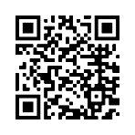

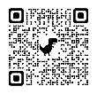
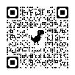
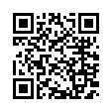
QR Codes Make it Easy!
QR Codes for Online Registration
QR codes make it easy to pull up websites from your phone. Just point your camera and click!
For Scouting , it QR codes are an incredibly valuable way to connect fliers, posters, yard signs and more to your event.
Remember those busy parents/guardians we need to reach? QR codes are also widely adopted by busy families as a fast and efficient way to find info they’re interested in.
Here are some helpful links (and QR codes!) to the Scouting America’s QR codes for online registration, a Google how-to for creating your own QR codes right from Google’s Chrome browser and a handy QR Code Generator.
On Scouting America’s Online Registration system, you can find a registration URL and QR code specific to your unit. Include this code wherever you want people to be able to register for your unit immediately online.
Create QR Codes for Everything Else!
Create a QR code for any URL using the QR code Creator in Google’s Chrome browser.
QR Code Generator is also a good place to create your own QR codes at no cost!
Notes:
QR codes make it easy to pull up websites. There are plenty of online options to help families navigate and it makes them go where we want them to, so they get the right information. We will be using QR codes throughout the presentation, so have those smart phones ready to go!

Slide 6



Social Media Can Help!
Create a unit Facebook group/page (see Scouting’s social media guidelines for details)
Promote upcoming activities and meetings
Shareable Social Media Post templates for the whole family to use
Notes:
Social media is a powerful tool to share information. We may complain about it often especially with how often our youth use it, but it can help get the good news of Scouting to families to plant the seeds of interest. As part of our “Share, Invite, Engage” initiative, this is a simple step we can all take to promote Scouting across our many friends and family.

Slide 7

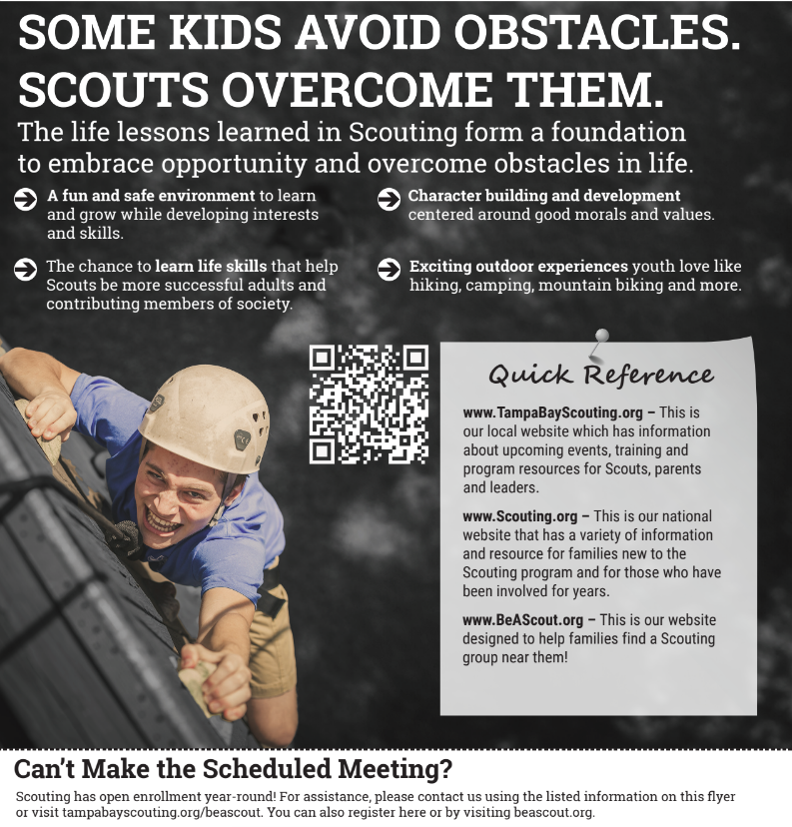

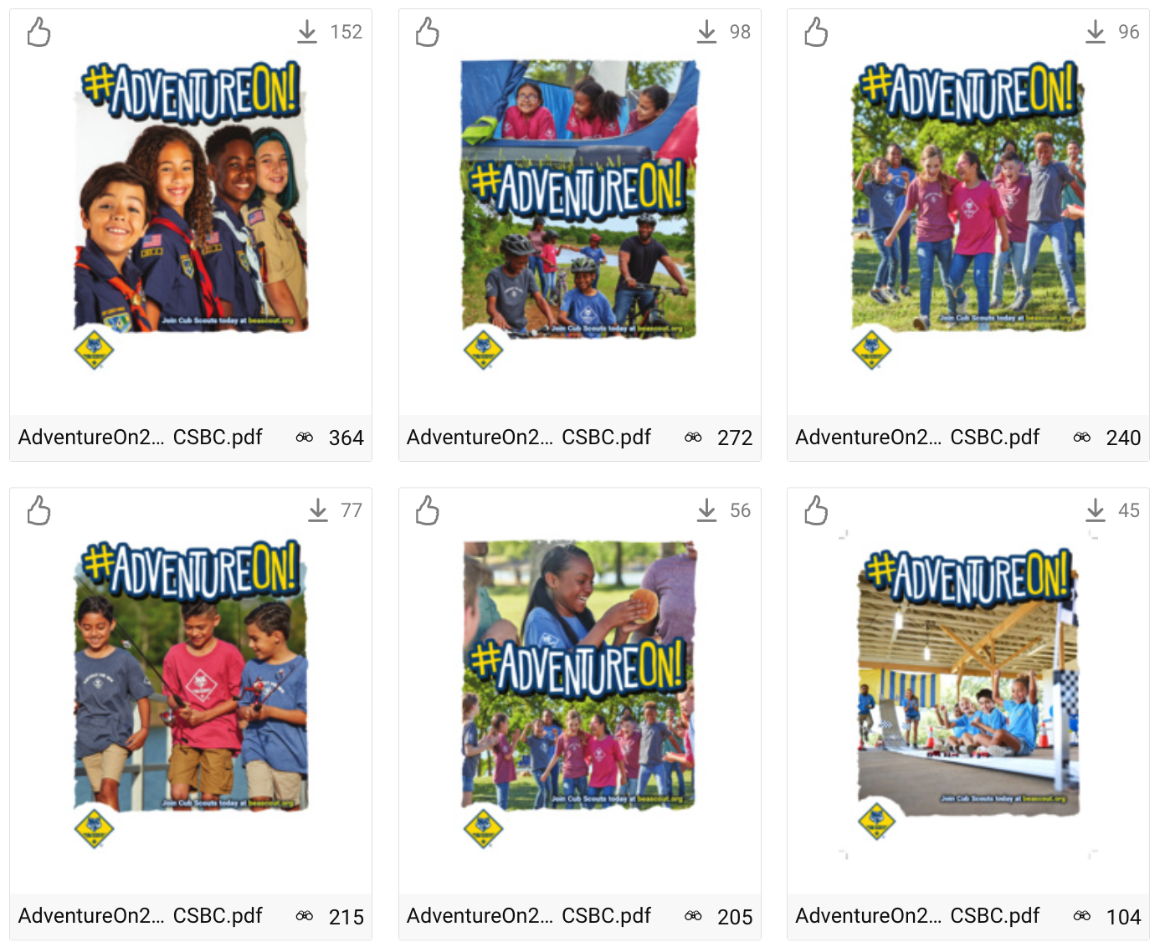
Use Fliers, Yard Signs and Posters
“All Scouting is Local.”
Because Scout units are community and neighborhood based, yard signs, fliers and posters are a good way to reach families in your area. Don’t just rely on schools! Distribute join Scouting fliers, posters, and yard signs in and around libraries and friendly businesses.
Ask local business to distribute fliers, for example local pizza restaurants may joining fliers to the top of pizza boxes.
Place yard signs where families go. Fast-food drive-thru, where school supplies are sold. Don’t forget your own home.
Make sure every flyer, poster or yard sign design includes a QR code to help direct families to your campaign event page. You can even create a unique QR code for each design to measure which type performed the best.
Brand Center…
The Scouting America Brand Center is the place to find videos, fliers, social media images and plans, posters, peer-to-peer cards and so much more!
Notes:
Fliers, yard signs and fliers have been a true and trusted method to pass on the good news of Scouting for many years. We plan to pass out over 200,000 fliers this Fall alone across the Tampa Bay area. But there are ways you can help before school even starts to promote Scouting and get families thinking about us.

Slide 8
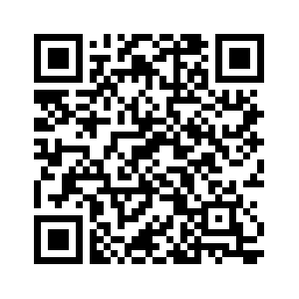
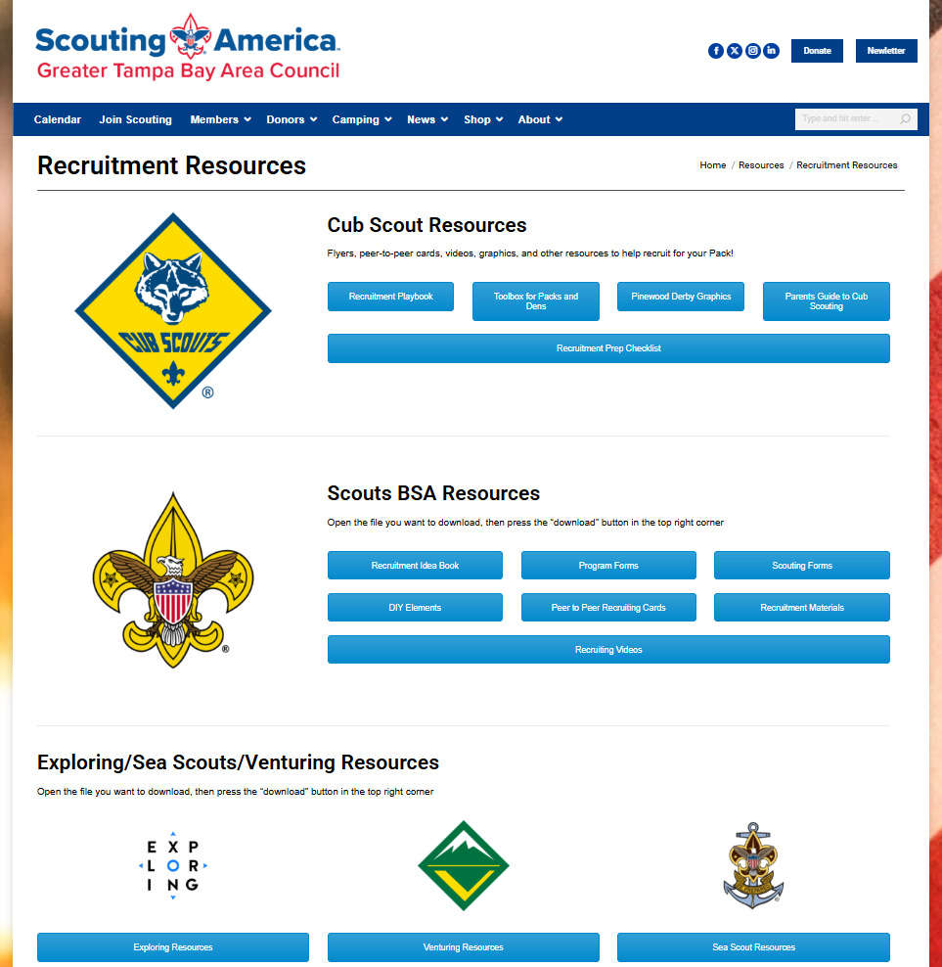
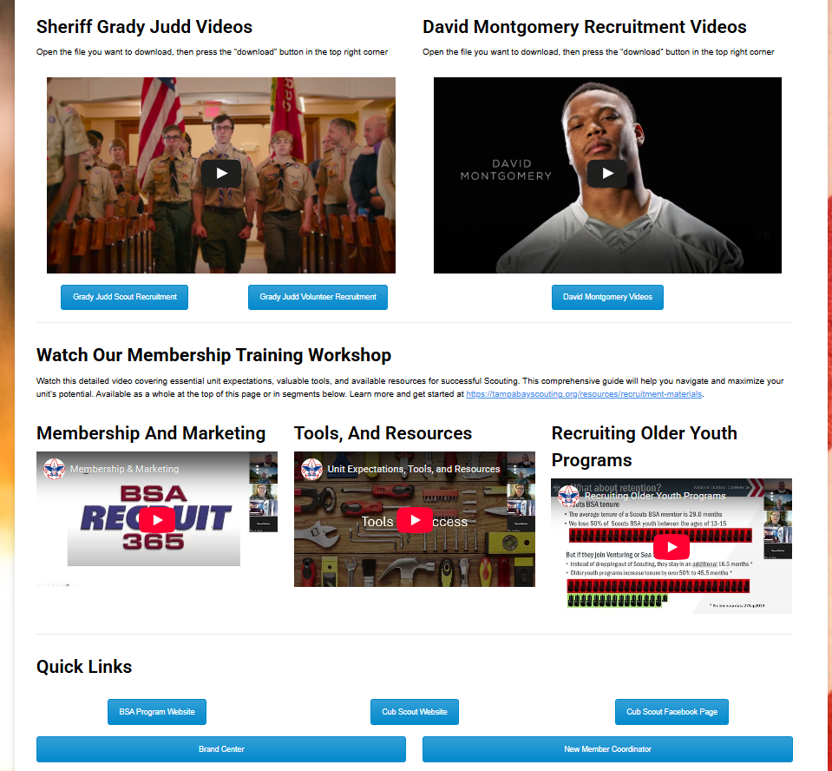
GTBAC Recruitment Resources
Tampabayscouting.org/leader-resources/recruitment-materials.org
Notes:
To assist your unit to be prepared for this Fall, we have all the recruitment resources you need. I’d like to especially highlight the videos showcasing Polk County Sheriff Grady Judd’s recruitment videos along with David Montgomery, Detroit Lions all-American running back/Eagle Scout, inviting busy families to join. These are just a few of the many resources at your fingertips to share Scouting and invite our community to join us. Scan the QR code to learn more.

Slide 9







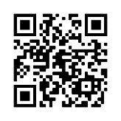


Web Banners
Resources
Find all of your #AdventureOn marketing assets on the Scouting America Brand Center.
DIY Headers/Footers
Adventure-Themed
Deliver brand promise through outdoor imagery
Dozens of digital and print assets available
Available on the Scouting America Brand Center
Bookmarks
Social Images
Posters & Fliers
Post Cards
Print Banners
Notes:
Another excellent resource is the National Brand Center website. Our theme is “Adventure On” this Fall and there are plenty of templates you can use and edit as needed. Scan the QR code to learn more.

Slide 10
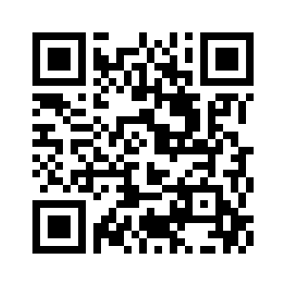
Geofencing and More
Generic recruitment advertisements on Facebook
Redirects families to our website to see all scheduled recruitments
They can filter by school or county to find one they want to attend
Units can share a recruitment event or school specific recruitment to potential new families
tampabayscouting.org/events
Notes:
And for those who scroll social media or browse the internet, you may have noticed the item you looked at one time is now following you. This is geofencing and is part of our recruitment campaign across the council. When you schedule a recruitment event at your local school, share the details with your Scouting professional and the council will add it to our “Events” page where families will be geofenced and can view different recruitment events across the council. If they don’t have time to visit their school’s recruitment, they can see the school down the street is holding a recruitment.

Slide 11
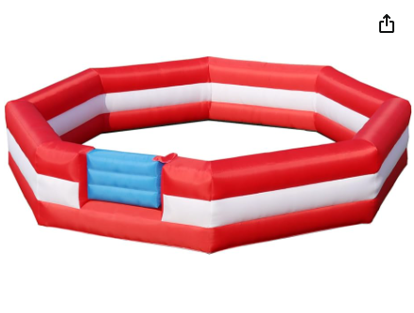
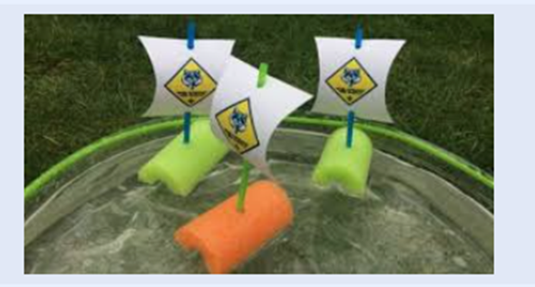
TASTE OF SCOUTING
Notes:
Sharing the good news of Scouting comes in many shapes and forms. The council offers easy activities your unit can check out from the office to use at recruitment events and open houses. We have a limited number of items, so contact your professional for more information and to schedule to check out an item.

Slide 12
Unit To Do’s - SHARE
Share an upcoming activity and/or photo on social media
Place 3 Scout yard signs in different locations (house, park, etc.)
Help schedule and lead your school’s sign-up night
Notes:
Here are 3 simple tasks we challenge you all to complete before the end of July.

Slide 13

STEP 2: INVITE
Recruit Families, not just youth

Slide 14

Build A “Welcome Team”
Unit New Member Coordinator
Notes:
A Unit’s New Member Coordinator will be an absolute must for everyone this year. It should be someone who is committed to growing Scouting.

Slide 15

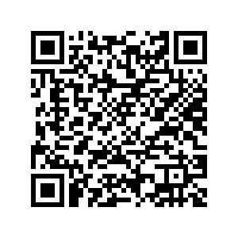


What do New Member Coordinators do?
scoutingwire.org/marketing-and-membership-hub/councils/new-member-coordinator/
Notes:
A new member coordinator’s role share the benefits of Scouting, coordinator unit recruitment and guide the joining and welcoming process. Scan the QR code to learn more about the new member coordinator. I challenge you to think of 1-2 individuals in your unit who could serve in this role. Our district membership team will be reaching out to talk to the units and gather their names and contact info, so we can work together.

Slide 16


Schedule YOUR Recruitments
Recruitment Date Set with school or other location in coordination with your Scout Professional
7-14 days before recruitment, event is geofenced on Facebook and boosted to families that match criteria. Most helpful if Unit and families share the event – more reach. ​
7-10 days before the recruitment, a digital or physical flyer is sent home along with a sign or signs placed at the school.​
1-2 days before the recruitment a Scout Professional or trained volunteer gives a Scout Talk in the classrooms (or other rally). If allowed, a flier is distributed to the students that day.​
The recruitment event is held at the school or other location with the New Member Coordinator plus other leaders/youth present.​
Units
SCHOOL
Units
SCHOOL
Units
Notes:
We are volunteer driven and professionally guided. Scheduling YOUR unit-led recruitments is a must! The timeline of events gives you an idea of what the expectation is when you set your recruitment dates. School adminstrators are back in the office starting mid-July. Work with your new member coordinator and scouting professional to get scheduling help and guidance.

Slide 17
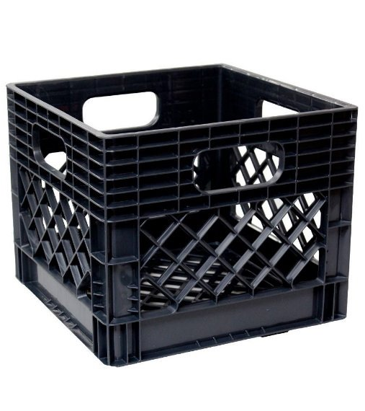
The Crate
Check-In Sheets w/QR code and paper sign-in sheet.
Program/Age Group Table Signs
Applications (youth, adult and Spanish)
Envelopes, Money Envelopes, Receipt Book, Change Bag, Square Reader w/Instructions
Pens
Yard Signs
Incentives
Bookmarks
Scholarship Printed Forms
Scouting Parent Orientation Guide (2-3 Copies- Have QR Code too)
GTBAC Annual Fees Infographic
Notes:
These crates are needed for your recruitment event. Once your recruitment event is scheduled, contact your Scout professional to get your hands on one of these babies. It’ll have everything you need to have a successful recruitment event and don’t forget to return it, so another unit can use it too!

Slide 18

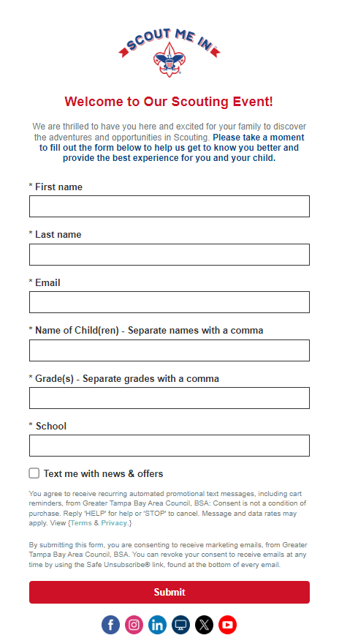

Get the Right Information
Recruitment Event Sign-In QR Code
Recruitment Event Sign-In Contact Information Page
Notes:
At a recruitment event, correct information is essential for communication, information and follow-up. Visiting families need to scan the QR code when they enter, complete the form and it will redirect them to our Parent’s Guide to Scouting. I’ve brought several copies for you to review. The guide works for any Scouting program and is simple to understand. While at your recruitment, use the guide as a guide of what to share and discuss. More importantly, KEEP IT SIMPLE!

Slide 19
Recruitment Event or Open House
Yard signs near parking lot and door entrance (“Enter Here”, “Meeting in Cafeteria”)
Scouts at the Doors to Welcome Families
Half Uniform, Half Unit Shirt
Sign In Sheet (QR Code sheet is preferred!)
Hands On Activity(ies)
Hand Outs
Youth Applications (Paper!)
Unit Activity Calendar (Next 90 Days)
Welcome to Scouting Resources (Parent Orientation Guide)
Get all Youth Applications Back (and turned into the office!)
Troops – attend Pack recruitment nights (5th graders!!)
Start on time, stay on task and keep it SIMPLE! (30 minutes)
Recruit them that night – they showed up for a reason
Join Scouting incentives (“If you sign-up tonight, you’ll receive…”)
Notes:
Here is an example of what a recruitment or open house can look like –
The half-uniform, half-unit shirt can seem odd to some of you, but it works. If everyone is in uniform, some families can feel intimidated. We want families to feel welcome
I mentioned before the importance of having a calendar ready to go. It doesn’t have to be a full 12 months, but just highlight the next 90 days to give the families a taste of what your unit does.
Bring your own unit specific “Welcome to Scouting” materials. The council professionals will also have items available and be sure to check out the recruitment resource webpage at www.tampabayscouting.org/recruitment
Every family that comes to a recruitment or open house should be handed a paper youth application whether your unit uses online applications or not. If the location that you are holding your recruitment doesn’t have good wifi or cell service for some reason, it’s an easy item for families to fill out and turn in. And PLEASE, get those paper applications turned in with 24 hours of your event.

Slide 20
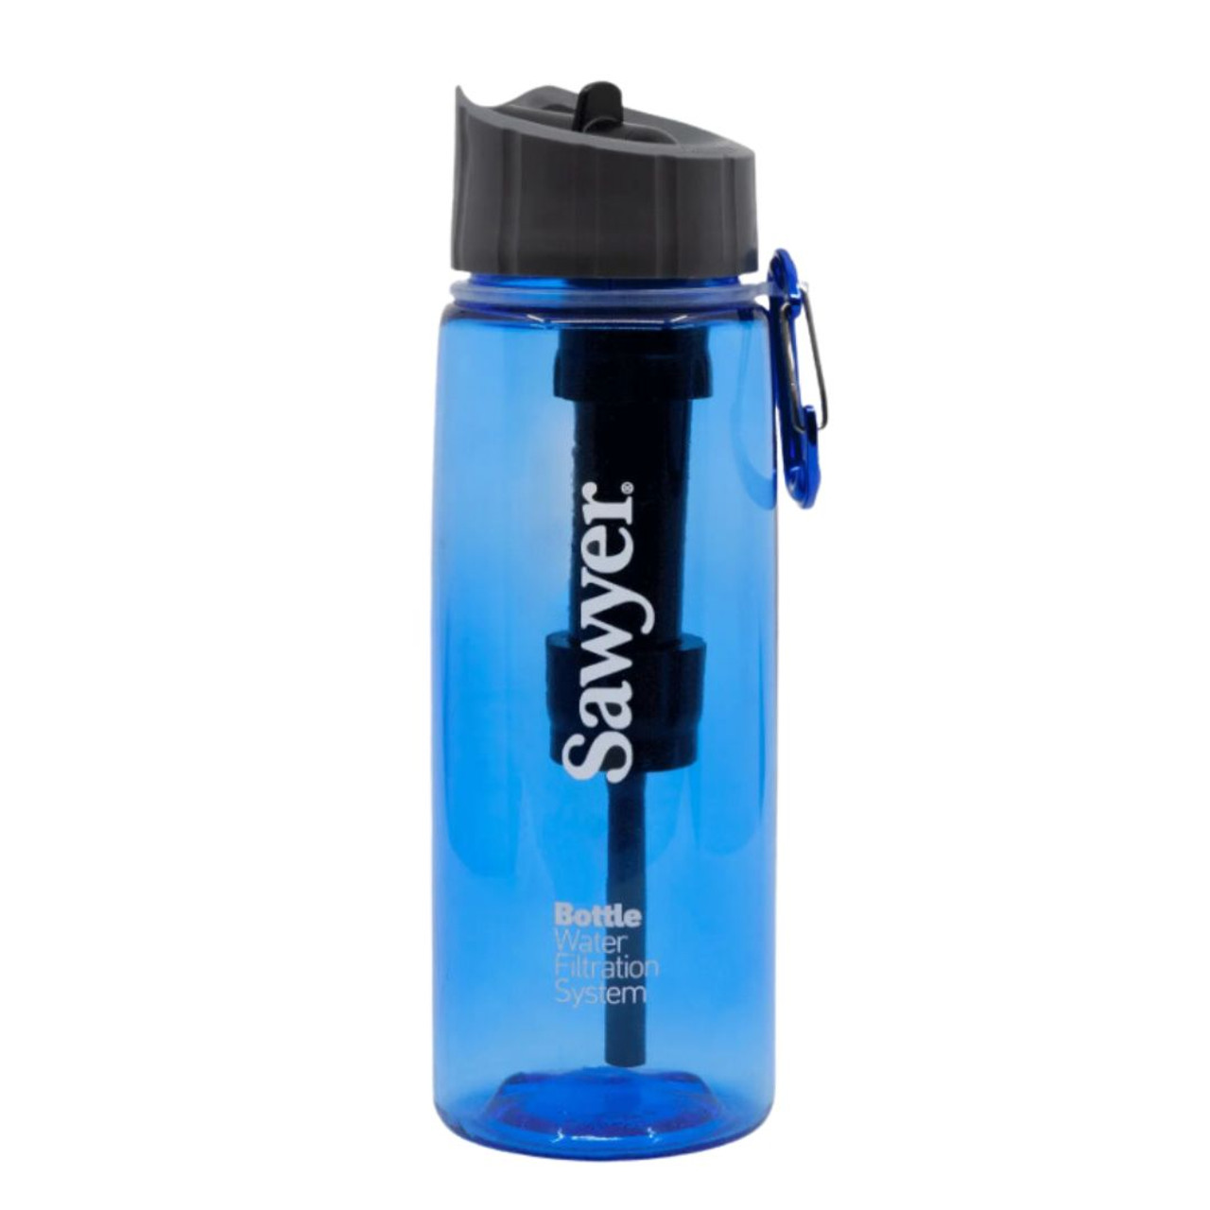
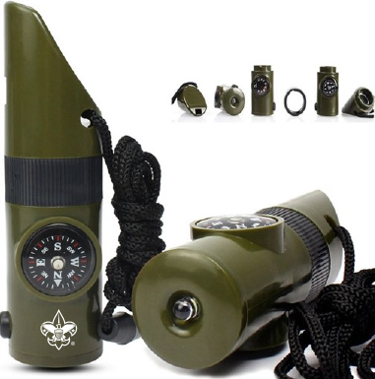

Families are Ready to Join
Get the family to register at the event “Tonight only, when you join, you will receive…”
Sign-up Incentives ​
Allowing them to register later loses 50% or more of the youth​
Online vs. Paper
Online is an easy excuse to “register later”​
Paper gets it done that evening​
Klarna (Buy Now, Pay later) platform ONLY available for online applications
Notes:
We have some great joining incentives this year with a 7-1 whistle, water bottle, free fall activities and a Cub specific welcome packet. We need to move away from letting families leave without signing up. They came for a reason, let’s get them signed up that night! Families will sign their kids up for soccer, football or other activities with little to no information, why would they not do the same with us??

Slide 21




New Cub Scout Welcome Kit
Being given to ALL New Cub Scouts who register
Designed to help with immediate engagement and encourage peer-to-peer recruiting with our new Cub Scout families.
Cub Scout Welcome Kit includes: 4” Car Magnet, 4” Sticker, 32-page special edition ScoutLife mini mag and a card with QR code to a welcome message and how the new Cub Scout can earn their Recruiter patch.
Notes:
Here is a Cub Scout specific incentive kids will receive the night they sign up.

Slide 22







Fall Events:
Sept. 5: Scout Day w/Clearwater Threshers
Sept. 12: Cub Fest (Polk, Highlands, Hardee Counties)
Sept. 27: Cub Fest at Camp Brorein*
Sept. 25 – 27: Aqua Camp at Flaming Arrow
Oct. 3: Scout Day w/Tampa Bay Rowdies
Oct. 3: Fall Fishing Day*
Oct. 9-11: Spook-O-Ree #1
Oct. 16-18: Spook-O-Ree #2
Sept. 27: Cub Fest at Sandhill*
Nov. 7: Merit Badge Academy
*FREE for all new Scouts
Notes:
Speaking of activities, we have great relationships with many of our sporting groups here in the Tampa Bay area. We just had the Scout days with the Tampa Tarpons and Lakeland Flying Tigers. These and other great partnerships in our communities are available to help with your yearly planning to help recruit and retain Scouts. Even if they don’t care for sports, there are STEM/NOVA events, Cub Activity Days at our camps and much more. Be sure when you’re planning your year, to have a blank calendar, a school calendar and the GTBAC calendar readily available. And what’s even better is our Cub Adventure events this Fall are FREE for new Scouts who join! Another great way to incentivize them to join and stay!

Slide 23
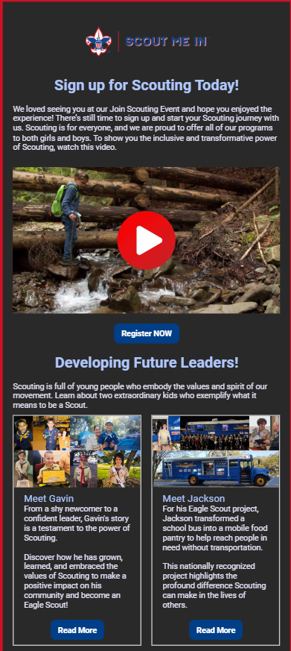
The Follow-up
Council:
1. Enter all application into system within 1-2 business days
2. Emails sent 2 hours after the event thanking them for coming (if QR code sign-in sheet was used)
3. Emails sent 4 days after recruitment event
4. Emails sent 8 days after recruitment event
5. Welcome to Scouting email goes out every Friday
6. Check-in emails sent 30, 60, 90 days after registration
Unit:
1. Collect applications as they say “yes”
2. Send a “Thank You” for attending message
3. Call, Text and/or Email the “maybes” – invite them to your next Unit Event
4. Send Welcome message to new Scout families from the unit
5. Turn in all completed applications and payment to the Service Center or your Scout Professional
Leader Tip: It can take up to 7 invitations for a family to commit, so KEEP ASKING!
Notes:
You can see here on the slide what the expectations are regarding follow-up from both the unit and the council. (Read the slide as needed)
I will emphasize the importance of using the QR code for the sign in at the recruitment event. Once they complete the info form, the council will send them a “thank you for coming” email within 2 hours of the event.

Slide 24
Unit To Do’s – INVITE
Invite a family or friend to attend an upcoming activity
Invite
Invite a member of the local school administration to attend an activity (pinewood derby, blue & gold, court of honor, etc.)
Participate in
Participate in at least 2 unit-led recruitment events
Invite
Notes:
Now it’s your turn. Here are 3 simple tasks I challenge you to complete as part of the “Invite” category.

Slide 25

STEP 3: ENGAGE
Every Parent and Guardian Helps

Slide 26

Stronger Families Through Scouting
Help Every Parent Be a Superhero
Notes:
Now, if you get parents engaged, let them lead (even just a little), give them tools to lead and succeed, recognize them and maybe give them an overstock patch as a recognition item, the parent should appreciate it (some might be embarrassed), but their child will feel proud: my dad was a hero. They love him. That builds stronger families right there.
And that Scout may bug his dad or mom and say: “can you come next time and help again – maybe you’ll get another patch”. Hey, if the patch recognition motivates a Scout to bug his parent to help you, use it.
Also, recently, I’ve thought about the Cubmaster as Hero image, and realized there is a downside: Some Cubs will look at their Cubmaster or Den Leader and may say to dad or mom: “I wish you could be as awesome as my Den Leader”. Some parents (especially dads) may feal threatened by that comparison, and less keen on doing Cub Scouting – but if you as a Cubmaster or Den Co-Leader elevate the other parents, your Scouts will see their parents as Superheroes, even if the parents don’t have a Khaki Superman outfit. Or don’t have it yet.

Slide 27
Helpers Can Turn Into Leaders
Do You Want – Or Do You Need – More Parent Involvement? If you get a lot of youth to sign up you need even more adults to deliver the program.
Many units don’t have all those roles filled with engaged active leaders.
Or some Packs have enough now, but if there is a big influx of new Scouts, a unit that used to have 45 Scouts with 6 Leaders and now has 90 Scouts will need 6 more Leaders and more help overall.
Every unit needs help doing parts of the leader jobs and the support of unit operations and activities.
Most units benefit from constant leader recruitment effort. Be aware of how parents might help

Slide 28
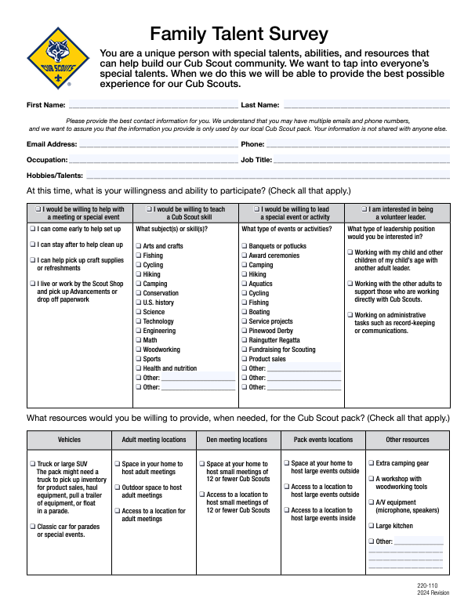
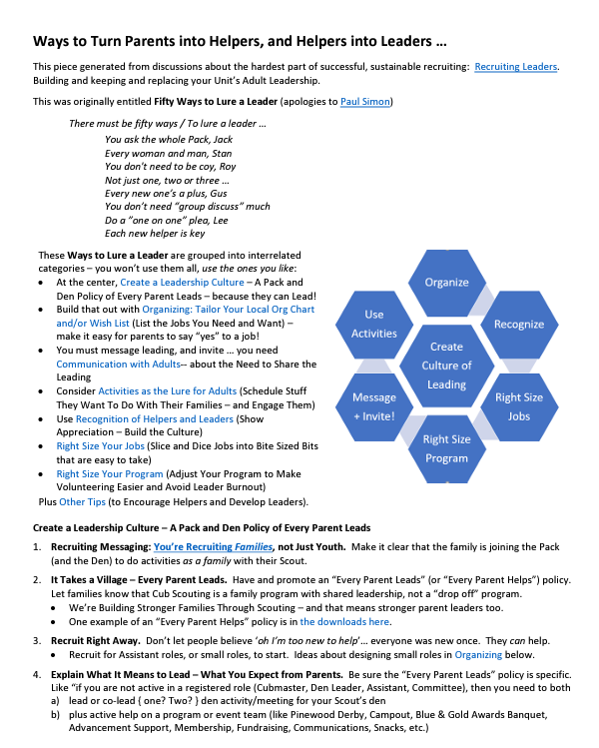
50 Ways to Recruit New Leaders
50 Ways List (credit: Atlanta Area Council)
Create a Team of Parent Leaders
Be an “Every Parent Helps” Unit
Ask for help a little at a time
Family Talent Survey
Notes:
These are resources from National and other councils to help you engage potential new leaders. Focus on the little things and tasks parents can do. We want people to feel wanted and appreciated. Don’t let families sit in the back of the room with their phones. Get them engaged!

Slide 29
Unit To Do’s - ENGAGE
Identify 1-2 leaders to assist with recruitment efforts (New Member Coordinators!)
Schedule a parent orientation meeting for new families within 1-2 weeks of joining
Host or participate in a fall Scout activity within 30 days of new families joining
Notes:
Here are 3 simple tasks you can do this month to help with the engagement.

Slide 30
Web Banners
Resources
Find all of your #AdventureOn marketing assets on the Scouting America Brand Center.
DIY Headers/Footers
Adventure-Themed
Deliver brand promise through outdoor imagery
Dozens of digital and print assets available
Available on the Scouting America Brand Center
Bookmarks
Social Images
Posters & Fliers
Post Cards
Print Banners
Notes:
Another quick review of our theme and resources available to you and your unit

Slide 31
GTBAC Recruitment Resources
Tampabayscouting.org/leader-resources/recruitment-materials.org
Notes:
Here are the GTBAC recruitment resource page

Slide 32
To Do’s - OTHER
Publish & Promote an ACTIVITY Calendar (MINIMUM 90 DAYS)
Update your BeAScout.org Pin
Conduct a service project at a school, park or organization
Take Scouting to the People
Notes:
Lastly, these are “Other” tasks I challenge you to complete in preparation of Fall recruitment season. Visibility is essential if we want families to join.

Slide 33
EASY AS 1,2,3…
SHARE – Promote your program!
01
INVITE – Recruit families, not just kids
02
ENGAGE – Every parent/guardian helps
03
Notes:
- Lastly, remember these 3 words – SHARE, INVITE, ENGAGE!

Slide 34
Teamwork Makes the Dream Work
Scouting is for EVERYONE!
Let’s Grow Scouting – (How many new families will YOUR unit embrace?)
Minimum 15% membership growth for each unit is the benchmark!
We must work together!
Notes:
Scouting is for EVERYONE and units must take charge of their own destiny by leading recruitment efforts! Here’s a great fall recruitment!

Slide 35


