Slide 1
College of Commissioner Science
DCS 509
A Legacy of
Servant Leadership
Revision date 5/1/2025

Slide 2
Learning Objectives
Explore characteristics of servant leaders
Understand servant leadership in Scouting
Recognize the legacy of servant leadership
Notes:
Learning Objectives:
In one of your first college of commissioner science experiences, you more than likely participated in a class called The Essential Element (A Servant’s Heart). That Bachelor’s level class introduced the concept of Servant Leadership and established the expectation that commissioners served units and other volunteers.
Today we are going to discuss characteristics of servant leaders, understand how servant leadership affects Scouting and talk about the legacy of servant leadership.

Slide 3
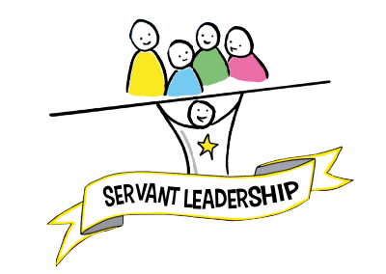
Notes:
How do we define Servant Leadership?
Simply put, servant leadership is people-centered, unselfish, and an investment in the lives of others. It is a sincere desire to help rather than control.
It reflects an inward sense of morality – right vs. wrong, rather than what’s in it for me. That is the difference between leadership that works and leadership that endures.
Can you think of some servant leaders? (Pause for 20-30 seconds and allow the participants to think of examples.)
Martin Luther King did not always want to be the leader of the Civil Rights Movement in the US, but he knew there was a need for equality. By putting other people’s needs first, he left a lasting legacy, proving that anyone can make a difference through humble service.
Nelson Mandela was a humble servant with a passion for his people and a desire to see them enjoy equality. Sometimes, he would take his speeches to the streets, putting his personal well-being at risk. He also endured harsh conditions in prison to ensure his statements were heard.

Slide 4

Characteristics of Servant Leaders
Listens for Understanding
Accepting
Leads by Example
Persuasive
Team Builder
Displays Humility
Notes:
Characteristics of Servant Leaders
Servant leaders listen rather than react – listening provides insight and a sense of direction. An Italian proverb says, “From listening comes wisdom.”
Acceptance—Anyone can lead perfect people. Lifting up imperfect people is a way to demonstrate acceptance and empathy, which in turn creates trust. Servant leaders believe that every person has value and deserves respect.
Lead by example – practice what you preach – hold yourself accountable for your commitments.
Persuasive rather than coercive (dictatorial). Rather than “I need you to…” the statement of a servant leader is “What can I do to help?”
Team builders set high standards for themselves and for those they serve, and are interdependent rather than ego-driven.
Humility – we all have flaws and shortcomings. Servant leadership allows us to become part of a cause worthy of our commitment.
You can be both a leader and a servant.

Slide 5
Servant Leadership in Scouting
Key 3
Eagle Projects/Community Service
Business models
Notes:
Servant Leadership in Scouting
The Key 3 model is an example of shared leadership, rather than a single voice at the top of the org chart, and encourages open discussion and honest feedback. Universities don’t operate for the benefit of the faculty; they are there to benefit students. Likewise, commissioners don’t work to benefit themselves; we are there to help leaders grow to their full potential.
Other examples of servant leadership in Scouting could include Eagle projects or community service.
Business models of servant leadership include FedEx, whose corporate philosophy is People-Service-Profit. This concept is based on the belief that creating a positive working environment for employees will provide better service quality, leading customers to use FedEx products and services.
The Fall 2020 edition of the Commissioner Newsletter states:
“Dedication, commitment, and energy are the keys to unit service. But don’t take my word for it. Ask a unit leader this question: Would you take a volunteer with little or no Scouting America experience who is wholly dedicated to the success of your unit, who will be consistently available to serve the unit, who will show up to unit meetings and events, who will be committed to take the training needed to understand the mechanics of Scouting America, and who, when they don’t know the answer to a question, will commit to finding the answer for the unit leader?
Most unit leaders would accept this type of engaged partner in their unit's success. Recruiting this type of servant leader for commissioner service from within and without Scouting America will positively impact the unit’s program and, thereby, the Scouts' experience in that unit. No other volunteer is better positioned to support a better unit program.”

Slide 6
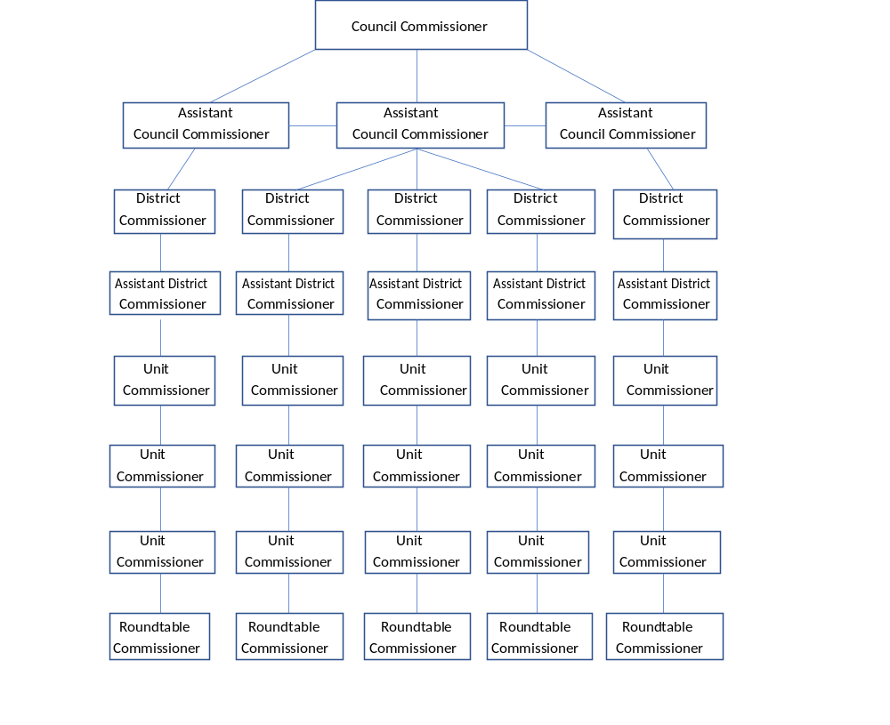
Organizational Chart
Notes:
Organizational Chart
This is an example of a typical org chart for commissioner service. Using scrap paper, outline an org chart reflecting your current volunteer or professional position. (Allow about 1 minute for this exercise.)
Done? Now, take the chart and turn it upside down.

Slide 7
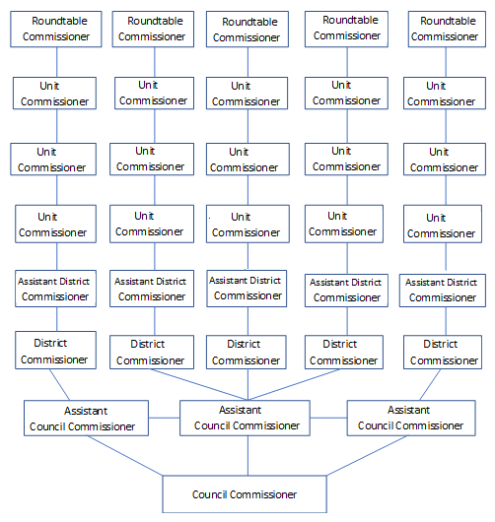
Servant Leader Chart
Notes:
Servant Leader Chart
When you turn the chart upside down, you get a vivid picture of what it means to be a servant leader.

Slide 8
Servant Leadership
Is an opportunity to be exceptional
Develops other leaders
Builds a cohesive team
Leading well means serving others!
Notes:
Servant Leadership
Servant leadership is your opportunity to be exceptional, to make a difference, and not to settle for something mediocre.
Servant leadership recognizes the potential in other people. Developing other leaders and helping them grow their own potential benefits not only the youth they serve, but the organization as a whole because it improves morale, loyalty, and investment into the mission of Scouting. And frankly, it makes your job easier because those leaders become more self-sufficient.
Building a strong, interconnected team means more gets done. If more gets done, programs will be better, leaders will be happier, and youth will have a better Scouting experience.
Leading well means serving others. Robert Greenleaf’s (Servant Leadership) acid test of a servant leader is summed up in this simple question: “Do the people around the person grow?”

Slide 9
Activity #1
Give yourself 1 point for each
sentence you think is a true
statement about you
Notes:
Activity – 5 minutes
For this exercise, the instructor will read the list of 20 characteristics of servant leadership.
Ask: Give yourself 1 point for each sentence you think is a TRUE statement about you.
Remind students that this is not a competition but an internal reflection. It is unlikely that everyone will answer all the statements true.
Following the activity, ask students if any of the statements strongly impacted them. Allow a few students to share which statements affected them and why.

Slide 10
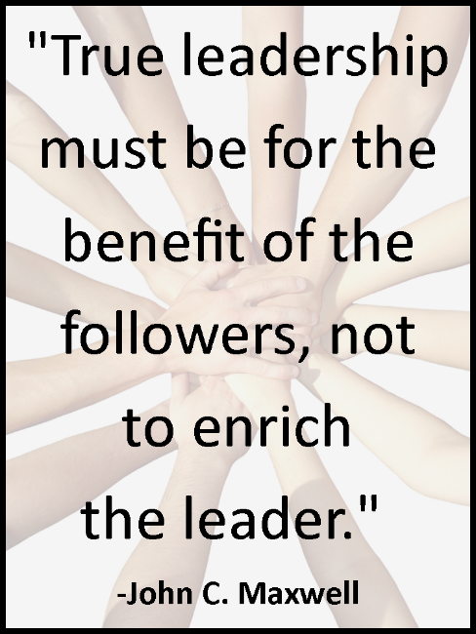
Notes:
John C. Maxwell Quote:
True leadership must be for the benefit of the followers, not to enrich the leader.
Many leaders impact the here and now. Servant leadership impacts future generations, and it is one way of leaving a legacy.

Slide 11
Leaving a Legacy
Leadership is everyone’s responsibility
Teaching is one way of serving
We all need loving critics – feedback is a gift
Forward-thinking is a leadership prerequisite
Notes:
Leaving a Legacy
There are four main characteristics of leaving a legacy through servant leadership. In the next few slides, we will explore how
Leadership belongs to everyone,
Teaching IS serving,
The value of constructive feedback, and
Leadership requires us to think ahead with future goals in mind.

Slide 12
Commissioners are leaders!
What kind of difference do you want to make?
Take responsibility.
If not you, then who?
Leadership
Notes:
Leadership is everyone’s responsibility, regardless of Scouting position. Can commissioners be leaders? Yes! They can and should be leaders.
None of us is the sole inhabitant of our organization or communities – we do not live alone. The legacy perspective explicitly reveals that we make a difference. The only remaining question is … what kind of difference do you want to make through your leadership?
When it comes to leading, each person has to take responsibility for their leadership quality.
If not you, then who?

Slide 13
One way of serving.
He who teaches learns twice.
Pass on legacy through stories.
Leadership is personal.
Teaching
Notes:
Consider that teaching is one way of serving.
The best way to learn is to teach. An old Chinese proverb says, “He who teaches learns twice.”
Legacies are passed on in the stories we tell. Our understanding of the Scouting position, district, or council is influenced by stories we have heard.
Leadership is personal. We are all reluctant to follow people if they are unwilling to tell us about themselves. We become suspicious and are less willing to trust.

Slide 14

Loving critics…
Feedback is a gift
Notes:
We all need loving critics. Feedback is a gift.
When you don’t see eye to eye with someone, seek to understand them. Focus on the purpose and not the person. The legacy from difficult conversations will be far more creative and sustaining than those who always agree.

Slide 15

Forward
thinking
Notes:
Forward-thinking is a leadership prerequisite. Leaders must articulate a vision and get others excited about it. You can’t lead without followers.

Slide 16

Leaders are followers, too!
Notes:
Leaders are followers, too. The best leaders are self-aware and realize their limitations. They are also secure enough to let go and let others take charge.
We follow a process, not a person. Too often, the word ‘follower’ is used negatively or critically. Leaders follow, too.
You don’t have to be THE leader to lead.

Slide 17
The legacy you leave is the life you lead.
Use each day to make a difference.
Each act contributes to your lasting legacy.
Notes:
The legacy you leave is the life you lead.
Each day provides countless chances to make a difference.
There are many moments each day you can choose to lead and many opportunities to make a difference.
Each of these moments serves up the prospect of contributing to a lasting legacy.

Slide 18

What is your legacy?
Notes:
What is your legacy?
Leading is not about what we gain from others but about what others gain from us.
What others say about you will not be about what you achieved for yourself, but for others.
What matters is not how big a campfire you built, but how well you kept others warm – how well you illuminated the night to make others feel safe – and how beautiful you left the campsite for those who come after you.

Slide 19
Activity #2
You have 5 minutes to think about your obituary!
What would someone write about you?
What impact have you had?
What legacy are you leaving?
Notes:
Activity #2 – 5 minutes
Write notes for things you would like included in your obituary while you think about your legacy.
How will people remember you when you are no longer in your current position?
If you are not leaving a legacy, what will you do to change that?
Or if you are taking on a new role, what will you do to leave a legacy?

Slide 20
Summary
Servant leaders listen, build teams, lead by example and demonstrate humility.
Commissioners should understand how servant leadership impacts Scouting .
Servant leadership leaves a legacy because it endures.
Notes:
Summary
Servant leaders listen, build teams, lead by example, and demonstrate humility.
Commissioners should understand how servant leadership impacts Scouting.
Servant leadership leaves a legacy because it endures.

Slide 21

Questions?
Comments!

