Slide 1


TBA – Commissioners Continuing Education Courses (CED 701 – 720)
May 16th, 2026 Commissioner College Bachelors, Masters and Doctoral Programs
Up Coming
Commissioner Training Courses

Slide 2


Welcome
To The 2025
College of Commissioner Science
Welcome Commissioners
Dean of the College
Dr. Torres

Slide 3
Greater Tampa Bay Area Council
2025 College of Commissioner Science
Dr. (Doc) Torres, Dean of the College
Dr. G. S. Torres

Slide 4
Please join me in the Pledge of Allegiance
Dr. G. S. Torres
Notes:
The Unit Service Plan is our primary tool that enables us to link unit needs to district operating committee resources. It was also a key element in the design of Commissioner Tools.
The Unit Service Plan is a better way to provide unit service. It supports all four elements of excellent unit service and our approach to starting and sustaining high-performing units (detailed in the Unit Performance Guide).
Based upon a collaborative assessment of unit health, commissioners develop a service plan that is customized to respond to a unit’s strengths and needs and draws upon resources available within the unit, its charter organization, and through the district operating committee.
Through ongoing unit contacts, commissioners capture periodic updates of the collaborative assessment of unit health and ensure the plan for improvement is moving forward.

Slide 5
The Scout Oath
The Scout Law
Dr. G. S. Torres
Notes:
The Unit Service Plan is our primary tool that enables us to link unit needs to district operating committee resources. It was also a key element in the design of Commissioner Tools.
The Unit Service Plan is a better way to provide unit service. It supports all four elements of excellent unit service and our approach to starting and sustaining high-performing units (detailed in the Unit Performance Guide).
Based upon a collaborative assessment of unit health, commissioners develop a service plan that is customized to respond to a unit’s strengths and needs and draws upon resources available within the unit, its charter organization, and through the district operating committee.
Through ongoing unit contacts, commissioners capture periodic updates of the collaborative assessment of unit health and ensure the plan for improvement is moving forward.

Slide 6
Introductions
Southern Region, Area 4
Council Service Territory Commissioner
William Gilliland

Slide 7
Introductions
Greater Tampa Bay Area Council
Scout Executive Mike Butler
Council President Benson Porter
Council Commissioner Matt Cordani
Director of Field Services Travis Emory

Slide 8
Introductions
Assistant Council Commissioners:
William Haggard
Matthew Kamat
Dr. G. Torres
Jim Ronayne
Dr. Eric Renker
Thomas Joseph McMullen
Bradley S. Luther

Slide 9
Introductions
District Commissioners
Charles Love Miccosukee District
John Timothy Bobo Suncoast
Ryan Cobin Skyway District
Elissa Motter Lake Region
David Edward Lane Thunderbird
Frank Brown Timucua
Donald Olivier Fort Brooke
John Joseph Coble Withlacoochee
Doc Torres Pathfinder

Slide 10
Introductions
Registrar of the College.
Matt Cordani
Assistant Registrar of the College.
Your Name Here
Dr. G. S. Torres
Notes:
The Unit Service Plan is our primary tool that enables us to link unit needs to district operating committee resources. It was also a key element in the design of Commissioner Tools.
The Unit Service Plan is a better way to provide unit service. It supports all four elements of excellent unit service and our approach to starting and sustaining high-performing units (detailed in the Unit Performance Guide).
Based upon a collaborative assessment of unit health, commissioners develop a service plan that is customized to respond to a unit’s strengths and needs and draws upon resources available within the unit, its charter organization, and through the district operating committee.
Through ongoing unit contacts, commissioners capture periodic updates of the collaborative assessment of unit health and ensure the plan for improvement is moving forward.

Slide 11
Introductions
Introduction of program Deans and their faculty.
Dr. G. S. Torres
Notes:
The Unit Service Plan is our primary tool that enables us to link unit needs to district operating committee resources. It was also a key element in the design of Commissioner Tools.
The Unit Service Plan is a better way to provide unit service. It supports all four elements of excellent unit service and our approach to starting and sustaining high-performing units (detailed in the Unit Performance Guide).
Based upon a collaborative assessment of unit health, commissioners develop a service plan that is customized to respond to a unit’s strengths and needs and draws upon resources available within the unit, its charter organization, and through the district operating committee.
Through ongoing unit contacts, commissioners capture periodic updates of the collaborative assessment of unit health and ensure the plan for improvement is moving forward.

Slide 12
Faculty of the Bachelor’s Program
Javier Fuentes, Dean
Paul McGrane
Alex Sobtzak
Don Olivier
Matt Cordani
Dr. G. S. Torres

Slide 13
Faculty of the Master’s Program
Tim Bobo, Dean
Matt Cordani
Mike Ferraz
Adam Clinkenbeard
Chris Perrys
Dr. G. S. Torres

Slide 14
Faculty of the Doctoral Program
Jim Ronayne, Dean
Matt Cordani
Dr. Eric Renker
Don Oliver
Bill Haggard
Frank Brown
Dr. G. S. Torres

Slide 15
Doctoral Review Board
All have a Doctoral of Commissioner Science Award Knot
Dr. G. Torres Jim Ronayne
Dr. Eric Renker Matt Kamat
Mark Kriz Mark Rose
Bill Haggard Roger Kline
Grace Hirigoyen Matt Cordani
Dr. G. S. Torres

Slide 16
What is a College of Commissioner Science?
The purpose of the College of Commissioner Science is to provide ongoing practical training for all commissioners to allow them to better serve their units.
Dr. G. S. Torres

Slide 17
Why do Commissioners need the College?
The mission of the Commissioner is to help the unit succeed.
Just as every Scout deserves a trained leader, every unit deserves a trained Commissioner!
The College offers the opportunity to:
Learn the information essentials to provide the best service to scouting units
Provide fellowship amongst the commissioner corps
Reinforce and expand on the lessons learned during previous training
Provide updates on commissioner service and scouting
Dr. G. S. Torres

Slide 18
Doctor of Commissioner Science Degree (DCS) Award Knot
(NOTE: Earning the Doctor of Commissioner Science Degree does not qualify you to receive the Doctorate of Commissioner Service Knot Award.)
A. Prerequisites
1. Current registration as a Commissioner
2. Current BSA Youth Protection Training certificate
3. Master of Commissioner Science Degree
4. Awarded the Commissioner Key
B. Course Requirements
1. Complete a minimum of ten additional courses of instruction for a total of twenty-four
2. At least five of the twenty-four must be from the Doctorate Degree level training.
3. Courses may not have previously been counted toward other college degrees.
C. Thesis or Project
1. This can be on any topic related to Commissioner Service.
2. The topic must be pre-approved by the Dean of the College, the Dean of Doctoral studies, and/or the Doctoral Review Committee.
3. Complete the thesis or project using the approved format as determined by the college.
D. The completed thesis or project must be approved by the Doctoral Review Committee ( See page 16 ). If a review committee is not used, at a minimum the Council Commissioner and the College Dean need to make the approval.
E. Commissioner Performance
1. Serve for at least one year on the College of Commissioner Science Staff (instructor or support staff), or work with training support for commissioners for at least one year
2. Approval of the Dean of the College, or Staff Adviser for Commissioner Service
3. Approval of Council Commissioner, or assigned Assistant Council Commissioner
4. Approval of your Council Scout Executive or Council Staff Adviser for Commissioner Service.

Slide 19
2025 GREATER TAMPA BAY AREA COUNCIL COLLEGE OF COMMISSIONER SCIENCE
Dr. G. S. Torres, Program Director
15 November 2025
GREATER TAMPA BAY AREA COUNCIL OFFICE
TIME
0830 – 0850 Breakfast and Introduction for ALL Colleges With Council Commissioner, Matthew Cordani
BACHELORS-Javier Fuentes, Dean MASTERS-Tim Bobo, Dean DOCTORATE- Jim Ronayne, Dean
0900 – 0950 BCS 101 MCS 302 DCS 501
Core Concepts Unit Service Support Unit/Member Renewal Selecting a Project /Thesis Topic
Javier Fuentes Tim Bobo Dr. Eric Renker
1000 – 1050 BCS 102 MCS 305 DCS 503
Unit/Member Renewal Process Resolve Critical Unit Issues Developing Your Project/Thesis
Paul McGrane Matt Cordani Bill Haggard
1100 – 1150 BCS 111 MCS 312 DCS 506
Comm. & S.A.F.E. Scouting Recruiting 21st Century Volunteer Coaching Commissioners Paul McGrane Mike Ferraz Don Oliver
1200 - 1300 LUNCH with Council Service Territory Commissioner Bill Gilliland & Council Commissioner Matt Cordani
1300 – 1350 BCS 119 MCS 315 DCS 507
Building Relationships Unit Service in Rural Communities Be a Project/Thesis Advisor Alex Sobtzak Adam Clinkenbeard Jim Ronayne
1400 – 1450 BCS 125 MCS 350 DCS 519
Commissioner Culture Unit/RT Commissioner Work Together Turning Relations into Partnership Don Olivier Chris Perry Dr. Eric Renker
1500 – 1550 BCS 152 MCS 354 DCS 551
Planning/Implement/Promote RT Scouts BSA RT Breakout Roundtable Today
A lex Sobtzak Chris Perry Frank Brown
1600 – 1650 CED-701 CED-701 CED-701
Combat Comm. Stress/Burnout Combat Comm. Stress/Burnout Combat Commiss. Stress
Matt Cordani Matt Cordani Matt Cordani
1700 – 1720 GRADUATION – Bachelors, Masters Colleges and Doctoral Colleges

Slide 20
First Things First:
Electronics
  cell phones/texting/laptop/iPad
You are encouraged to take notes - and ask questions!
Facility Layout
Refreshments, brought to you by Publix
Be Punctual
Wear face masks if you feel the need.
Notes:
We want you present and undistracted. Please turn off electronics and remove from the table. Not only are you distracted by your device, others around you are also distracted.
We have added personal stories to our presentations to make them more interesting. If everyone in the room adds a story, we’ll be here for a long time!
Give layout of facility. Restrooms. Cafeteria.
If you brought the “big bubba pail of coffee”, please fill it at the cafeteria.

Slide 21
Our sources of information:
www.scouting.org
Other NATIONAL BSA websites
Official publications
(use current editions)
Dr. G. S. Torres

Slide 22
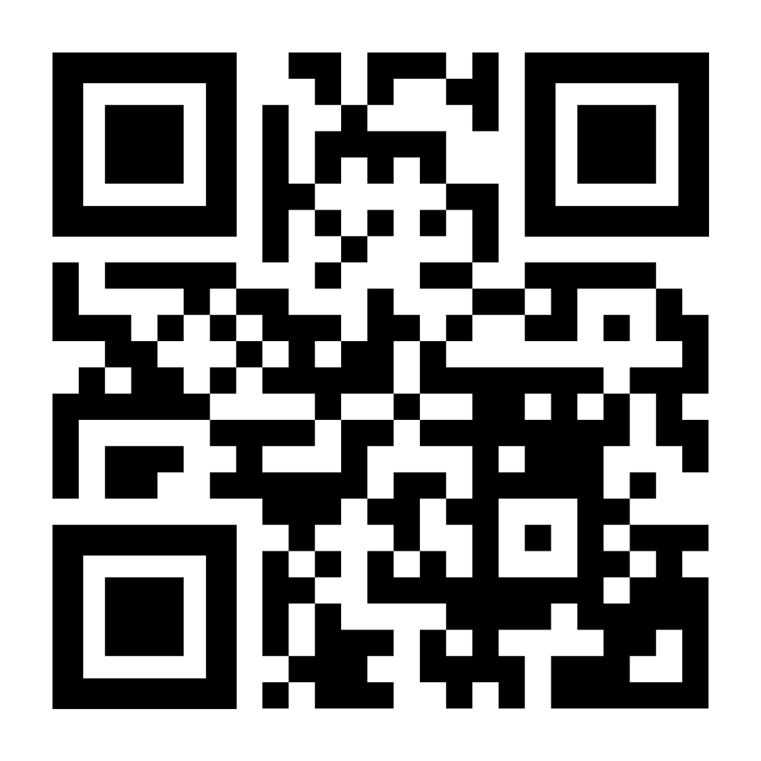
Our sources of information:
Dr. G. S. Torres

