Slide 1
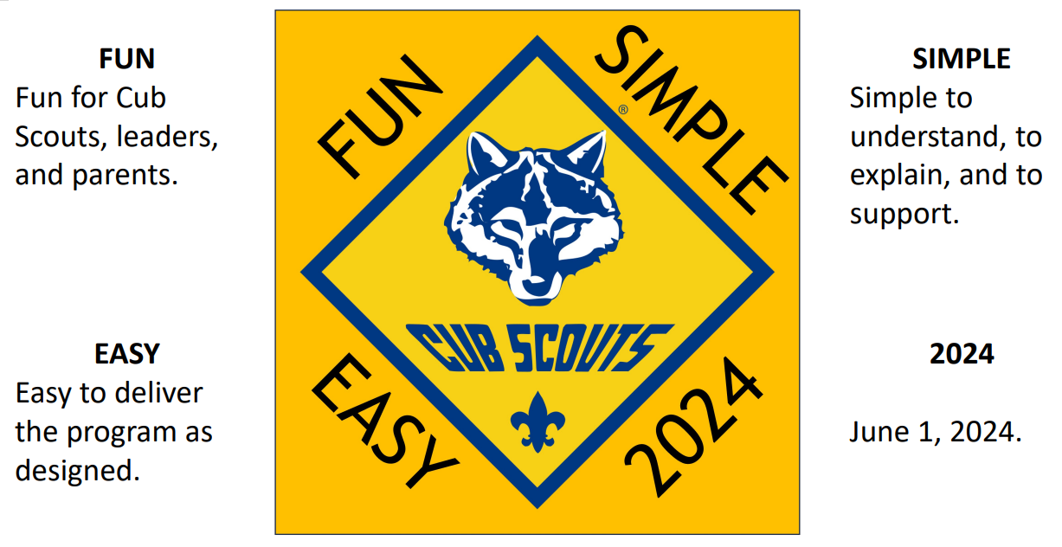
Cub Scout Program Changes 2024
Alex J. Sobtzak Sr.
Cub Scout Roundtable Commissioner
Withlacoochee District
Greater Tampa Bay Area Council
alex@sobtzak.com
(813)404-4966

Slide 2
Agenda

Slide 3
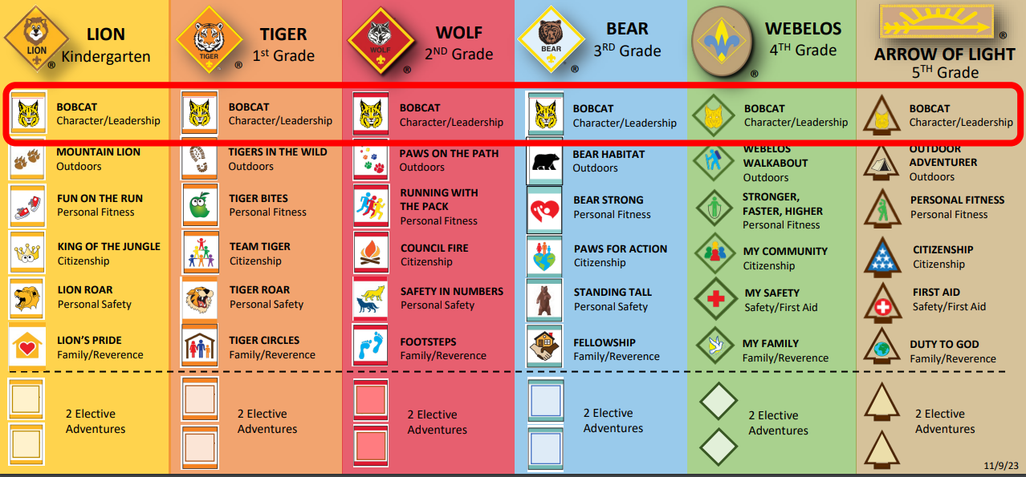
Bobcat Adventures

Slide 4
Bobcat Adventures Requirements Examples
Lion Bobcat
Get to know the members of your den.
Have your adult partner or den Leader read the Scout Law to you. Demonstrate your understanding of being friendly.
Share with your adult partner, during a den meeting or at home, a time when you have demonstrated the Cub Scout motto “Do You Best”
At home, with your parents or legal guardian do the activities in the booklet “How to Protect Your Children from Child Abuse: A parent’s Guide”
Bear Bobcat
Get to know members of your den.
Recite the Scout Oath and Scout Law with your den and den leader.
Learn about the Scout Oath. Identify the three points of the Scout Oath.
With your den, create a Den Code of Conduct.
Learn about the Denner position & responsibilities.
Demonstrate the Cub Scout sign, Cub Scout salute and Cub Scout handshake. Show how each are used.
Share with your den, or family, a time when you demonstrated the cub Scout motto “Do Your Best”. Explain why it is important to do your best.
At home, with your parents or legal guardian do the activities in the booklet “How to Protect Your Children from Child Abuse: A parent’s Guide”
Arrow of Light Bobcat
Learn about the patrol methos and discuss the benefits.
Choose a patrol name and elect a patrol leader.
Make a patrol flag that includes everyone’s name.
Recite the Scout Oath and Scout Law with your patrol.
With your patrol develop a Code of Conduct.
Demonstrate the Scouts BSA sign, salute and handshake. Show how each are used.
With your patrol or with your parent/legal guardian visit a Scouts BSA Troop.
At home, with your parents or legal guardian do the activities in the booklet “How to Protect Your Children from Child Abuse: A parent’s Guide”

Slide 5
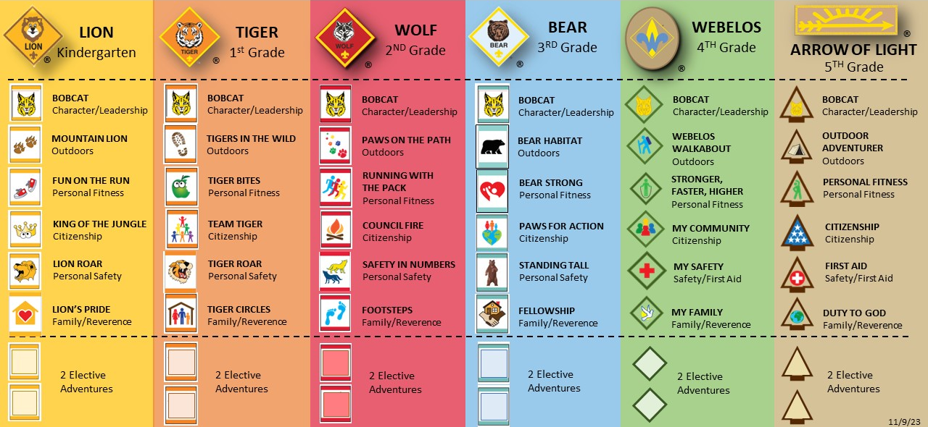
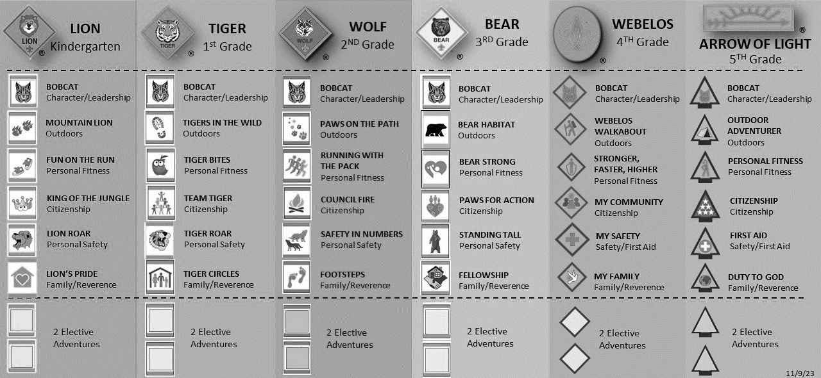
Cub Scout Advancement Trail

Slide 6
Cub Scout Advancement Trail
Across all ranks, the required adventures are focused on character and leadership. The Outdoors, Personal Fitness, Citizenship, Personal Safety and Family/Reverence.

Slide 7
Common Activities for Required Adventures
Lion
Mountain Lion
Requirement #2
Take a walk outside spending at least 20 minutes exploring the outdoors with your Cub Scout Six Essentials
Tiger
Tigers in the Wild
Requirement #3
Take a walk outside spending at least 20 minutes exploring the outdoors with your Cub Scout Six Essentials
Wolf
Paws on the Path
Requirement #5
Take a walk outside for at least 30 minutes to explore nature in your surroundings. Describe four different animals that you could see on your walk.
Bear
Bear Habitat
Requirement #5
Go on a 1-mile walk. Identify six signs of any mammals, birds, insects, reptiles, or plants. Discuss the Leave No Trace principles.
Webelos
Webelos Walkabout
Requirement #5
Using the buddy system, Walk your planned 2 miles. Discuss what a helpful buddy does in an outdoor environment and what to do if separated from the group.

Slide 8
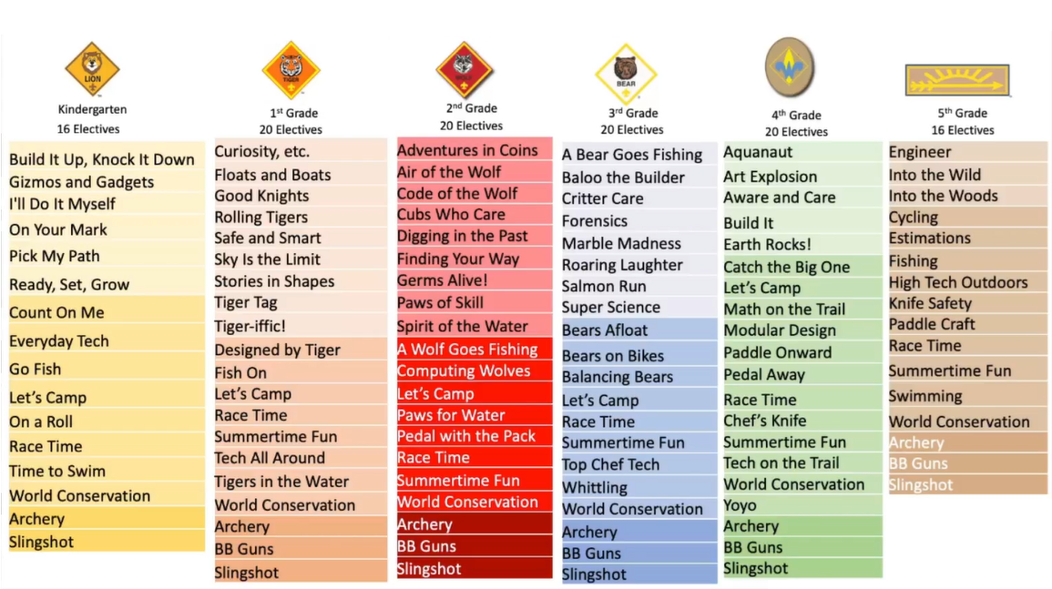
Cub Scout Elective Adventures

Slide 9
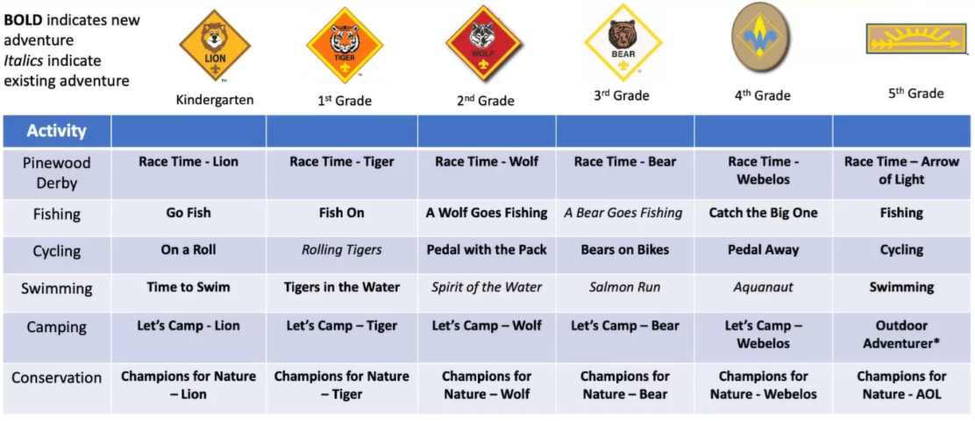
Adventures Available for All Ranks

Slide 10
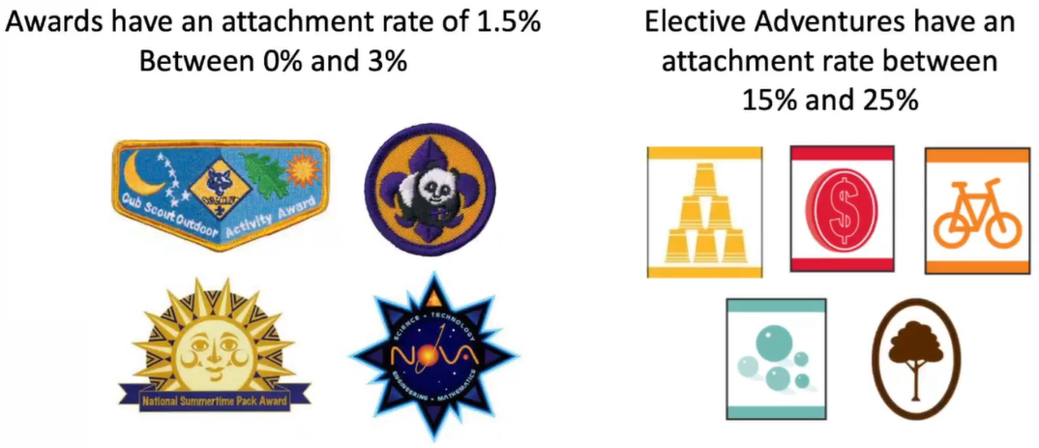
Awards

Slide 11
PLAN NOW for Summertime Fun
Notes:
The National Summertime Pack award has been reimagined into an elective Adventure named Summertime Fun. This new Adventure may be one of the simplest Adventures, it has one requirement and that is: anytime during May through August participate in a total of three Cub Scout activities.
As the National Summertime Pack award was evaluated it was deemed a valuable method to promote summer activities such as Cub Scout Day Camp and Cub Scout Resident Camp. It was also determined that requiring a percentage of participation for the National Summertime Pack award was unfair to those who attended when the percentage of participation was not achieved.
The new Summertime Fun elective Adventure is available for Tiger through Arrow of Light. Lions do not begin Cub Scouting until they are attending Kindergarten in the fall so there are no summertime activities for Lions.

Slide 12
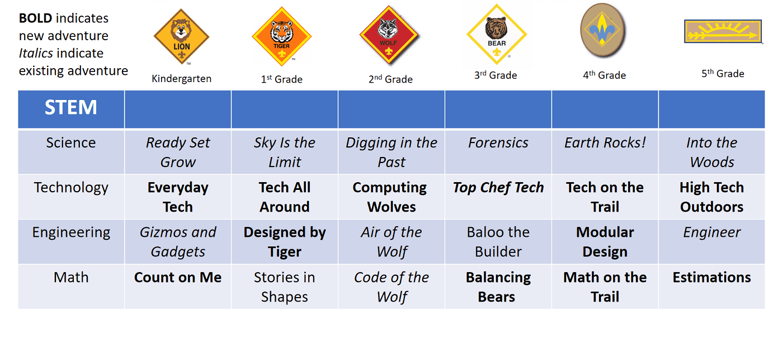
Stem Adventures
Notes:
A review of elective Adventures was conducted to identify areas where the Cub Scout Adventures were lacking in the areas of science, technology, engineering, and math (STEM). Cub Scouting already had a lot of great science-based elective Adventures. There were gaps in technology, engineering, and math.
New elective Adventures were developed to ensure that each rank has at least one elective Adventure based on science, technology, engineering, and math.

Slide 13
Knife Safety

Slide 14
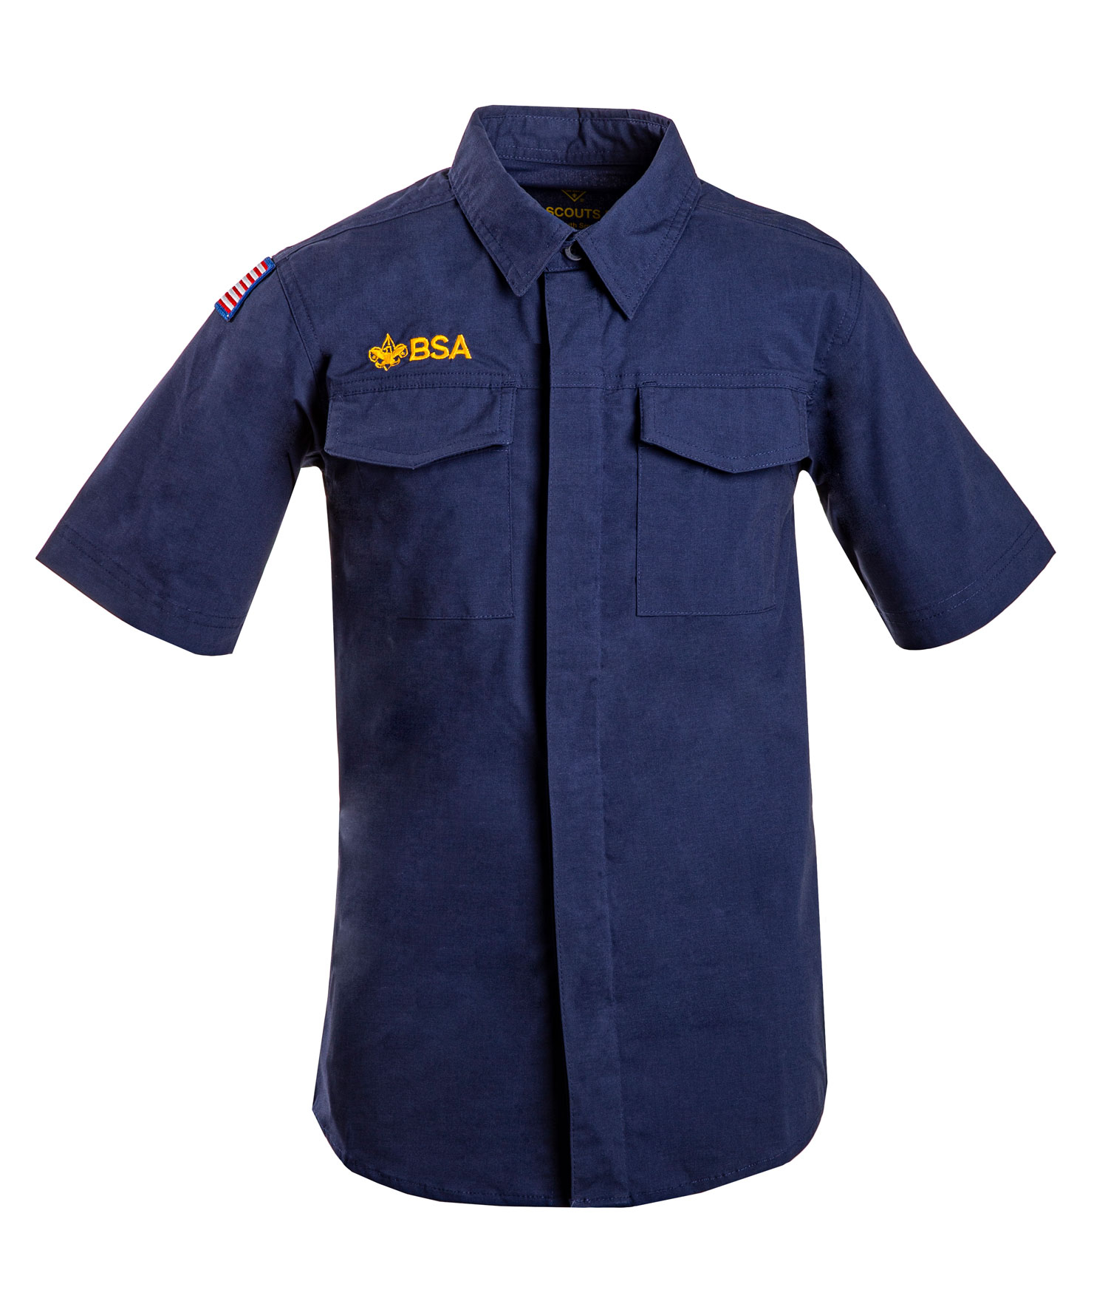
Uniforms

Slide 15
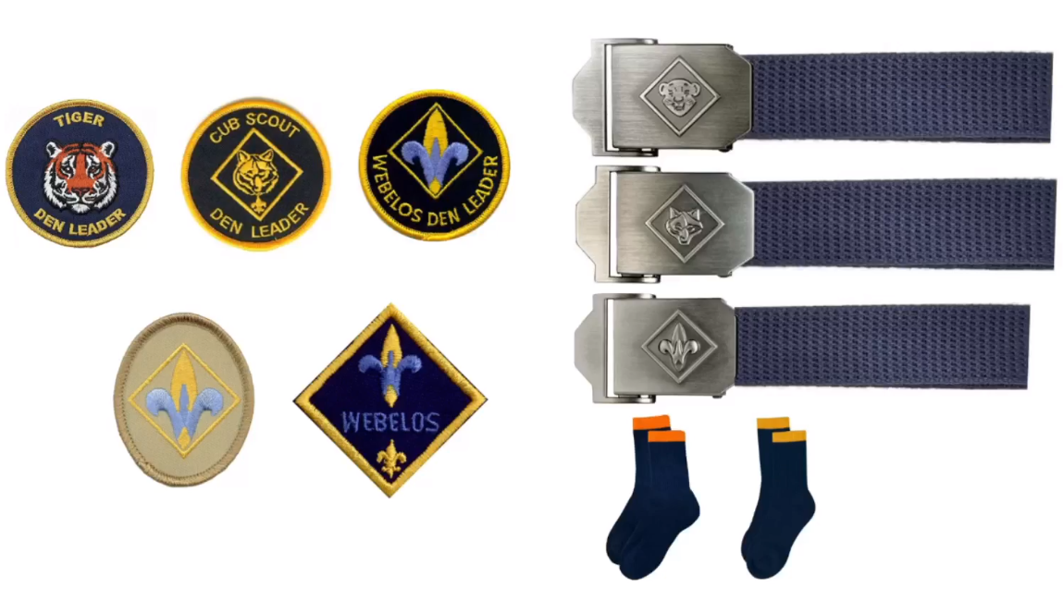
Simply the Uniform

Slide 16
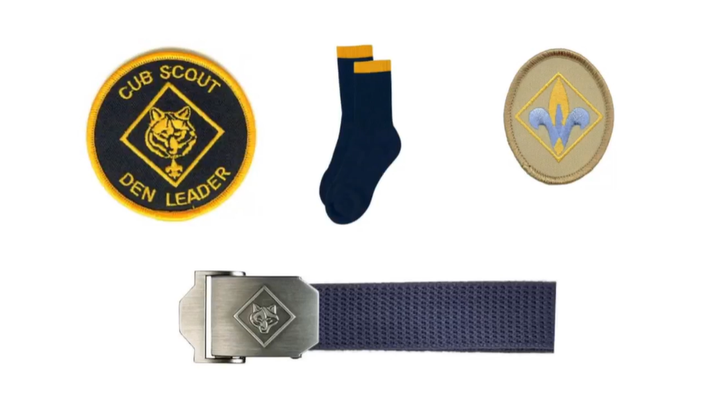
Simply the Uniform

Slide 17
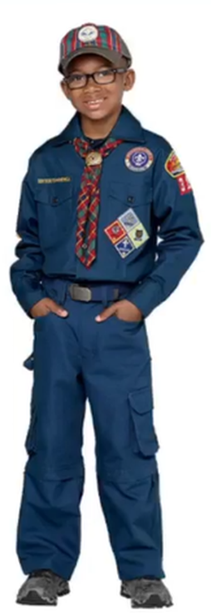
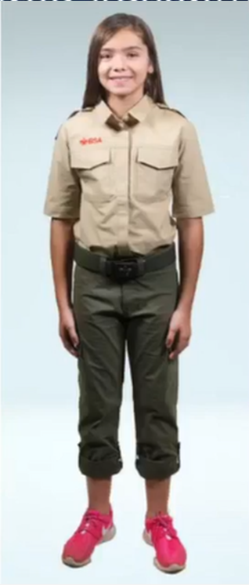
Simply the Uniform
4th Grade Webelos
Blue Cub Scout Uniform
Webelos Hat
Webelos Neckerchief
5th Grade Arrow of Light
Scouts BSA Uniform
Tan Shift
Green Bottoms
There will not be an Arrow of Light Hat or Neckerchief

Slide 18
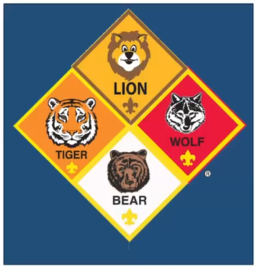
Simply the Uniform (Lion Rank)

Slide 19
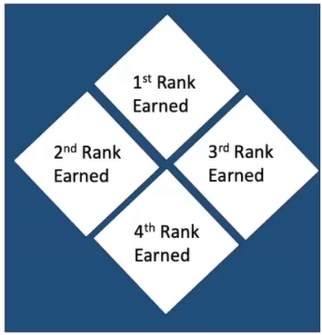
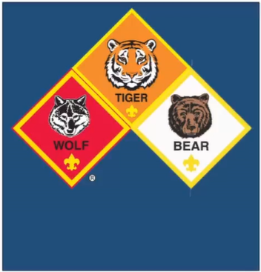
Simply the Uniform (Badges of Rank)
Lion >>> Bear badges of rank positions on the uniform is now based on the order earned.
Current Cub Scouts do not need to change their uniform.

Slide 20
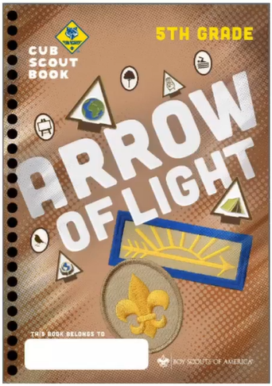
Simply the Handbooks

Slide 21
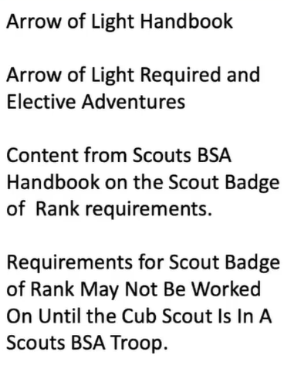
Simply the Handbooks

Slide 22
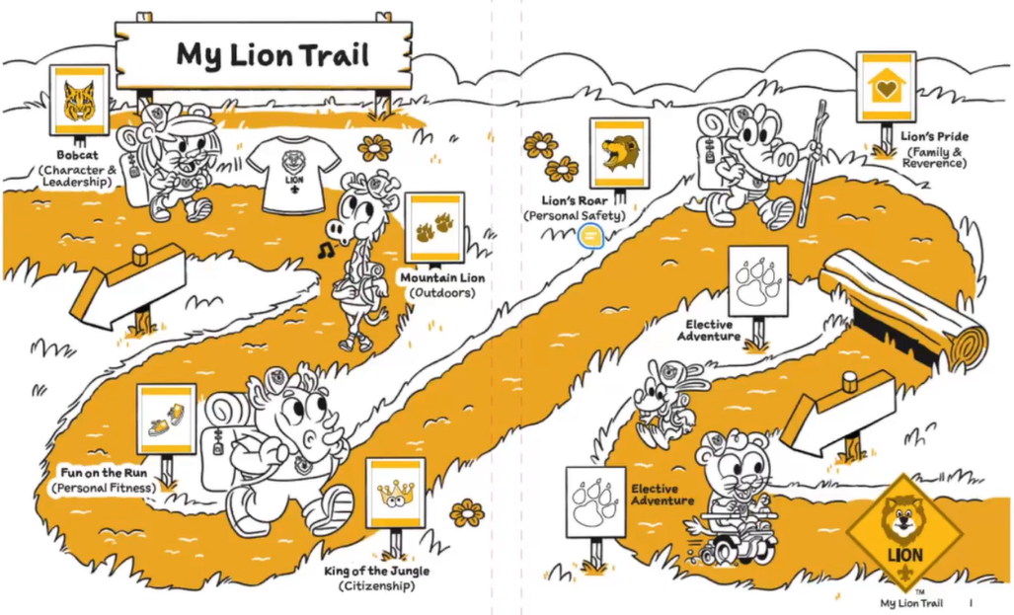
Simply the Handbooks (Lions)

Slide 23
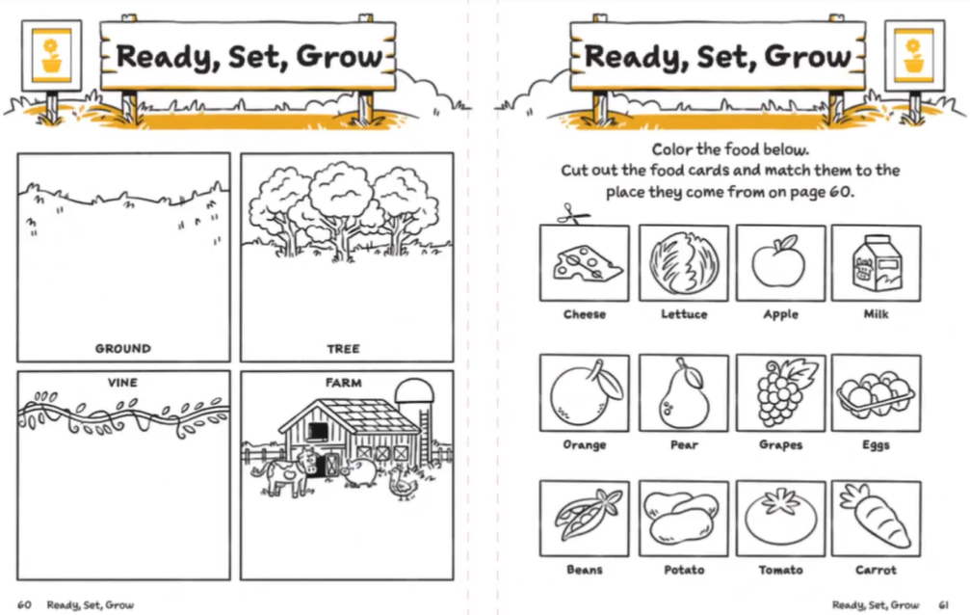
Simply the Handbooks (Lions)

Slide 24
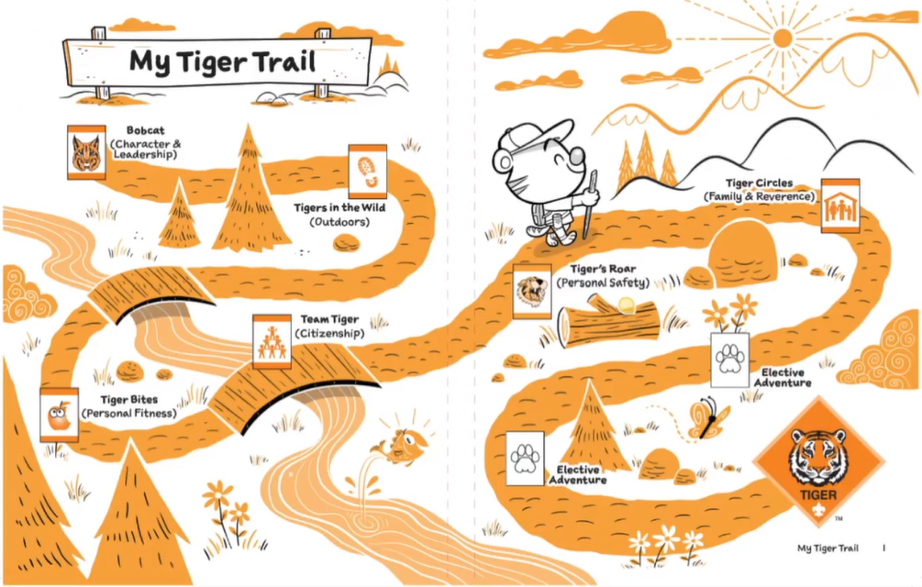
Simply the Handbooks (Tigers)

Slide 25
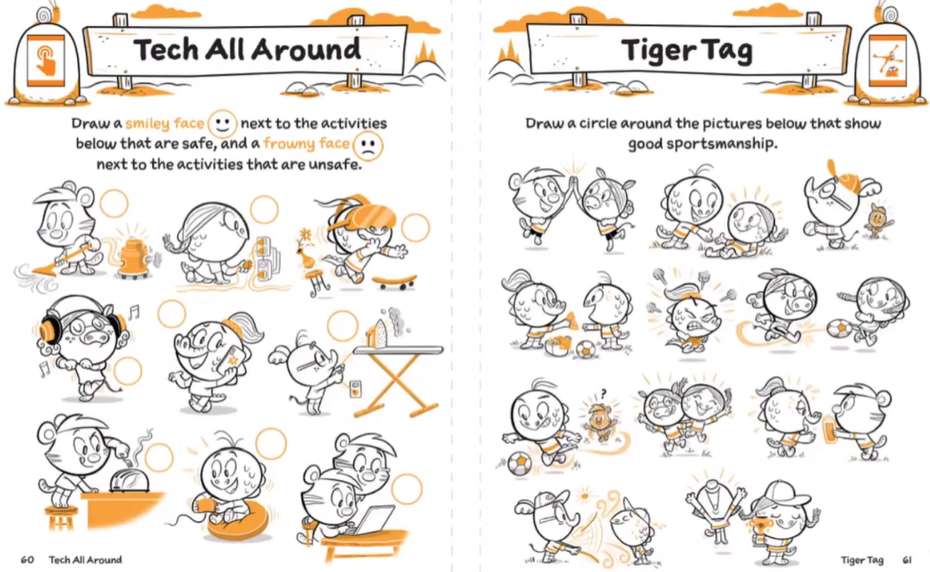
Simply the Handbooks (Tigers)

Slide 26
Simply the Handbooks (Wolf)

Slide 27
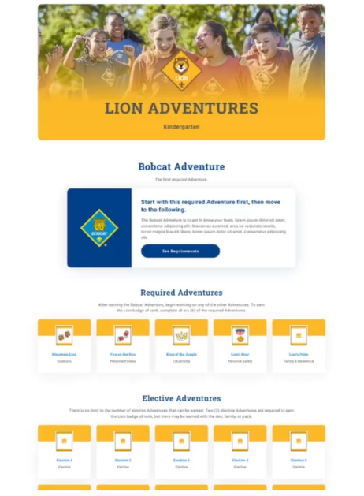
Resources
https://www.scouting.org/programs/cub-scouts/adventures/

Slide 28
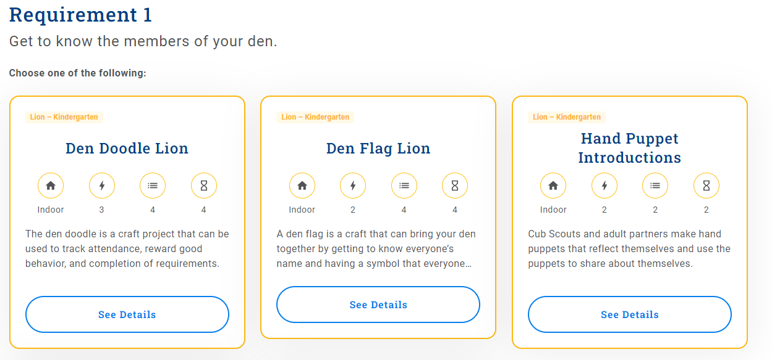
Activity Cards for Requirements

Slide 29
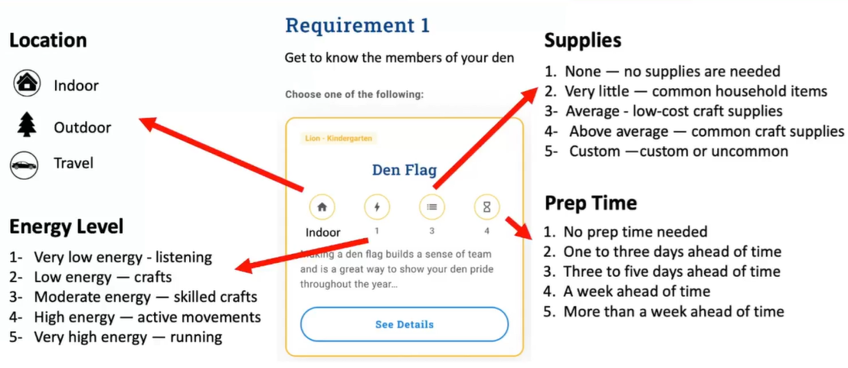
Activity Cards for Requirements

Slide 30
Webelos / Arrow of Light

Slide 31
ATTENTION! Current 4th grade Webelos
Current 4th grade Webelos should NOT begin work on Arrow of Light.
Current 4th grade Webelos should work on elective Adventures which will not be available next year as an Arrow of Light elective.

Slide 32
Simply the Uniform
4th Grade Webelos
Blue Cub Scout Uniform
Webelos Hat
Webelos Neckerchief
5th Grade Arrow of Light
Scouts BSA Uniform
Tan Shift
Green Bottoms
There will not be an Arrow of Light Hat or Neckerchief

Slide 33
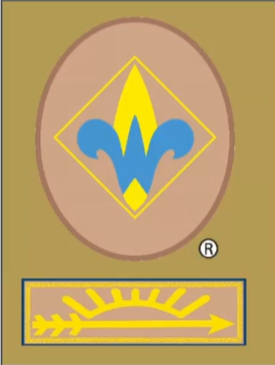
Simply the Uniform

Slide 34
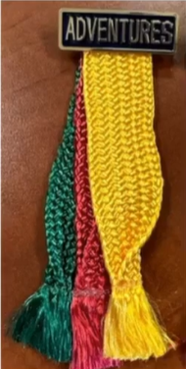
Simply the Uniform

Slide 35
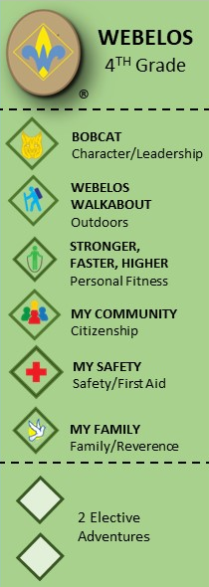
Cub Scout Advancement Trail
Webelos will no longer be a program to prepare Cub Scouts for Scouts BSA. Webelos is now simply the 4th grade rank of Cub Scouts. This eliminates the terms Webelos 1 and Webelos 2

Slide 36
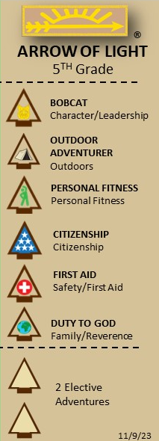
Cub Scout Advancement Trail
AOL becomes a stand-alone badge of rank and no longer associated Webelos. AOL becomes the badge rank that prepares Cub Scouts for Scouts BSA. They no longer share electives.

Slide 37
Current Webelos Electives Adventures
Current Webelos Elective Adventures | Webelos 4th Grade | Arrow of Light 5th Grade
Aquanaut | Aquanaut | NO
Art Explosion | Art Explosion | NO
Aware and Care | Aware and Care | NO
Build It | Build It | NO
Castaway | Sunset | Sunset
Earth Rocks | Earth Rocks | NO
Engineer | NO | Engineer
Game Design | Sunset | Sunset
Into the Wild | NO | Into the Wild
Into the Woods | NO | Into the Woods
Sports | Sunset | Sunset
Yo-Yo | Yo-Yo | NO

Slide 38
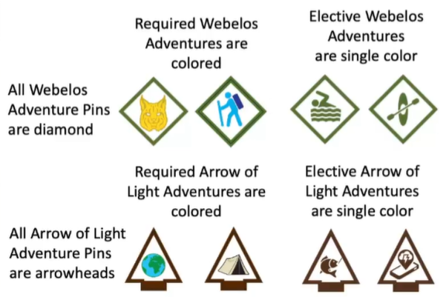
Simply the Uniform

Slide 39
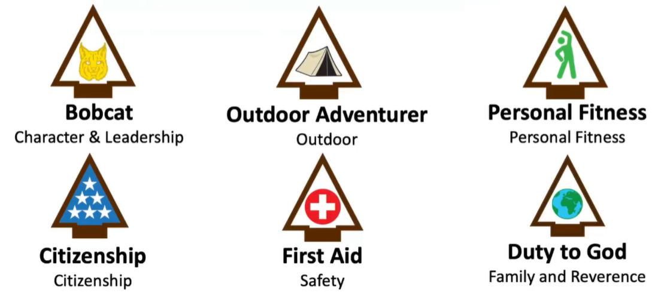
Arrow of Light Required Adventures

Slide 40
Arrow of Light Bobcat Requirement
Learn about the patrol methos and discuss the benefits.
Choose a patrol name and elect a patrol leader.
Make a patrol flag that includes everyone’s name.
Recite the Scout Oath and Scout Law with your patrol.
With your patrol develop a Code of Conduct.
Demonstrate the Scouts BSA sign, salute and handshake. Show how each are used.
With your patrol or with your parent/legal guardian visit a Scouts BSA Troop.
At home, with your parents or legal guardian do the activities in the booklet “How to Protect Your Children from Child Abuse: A parent’s Guide”

Slide 41
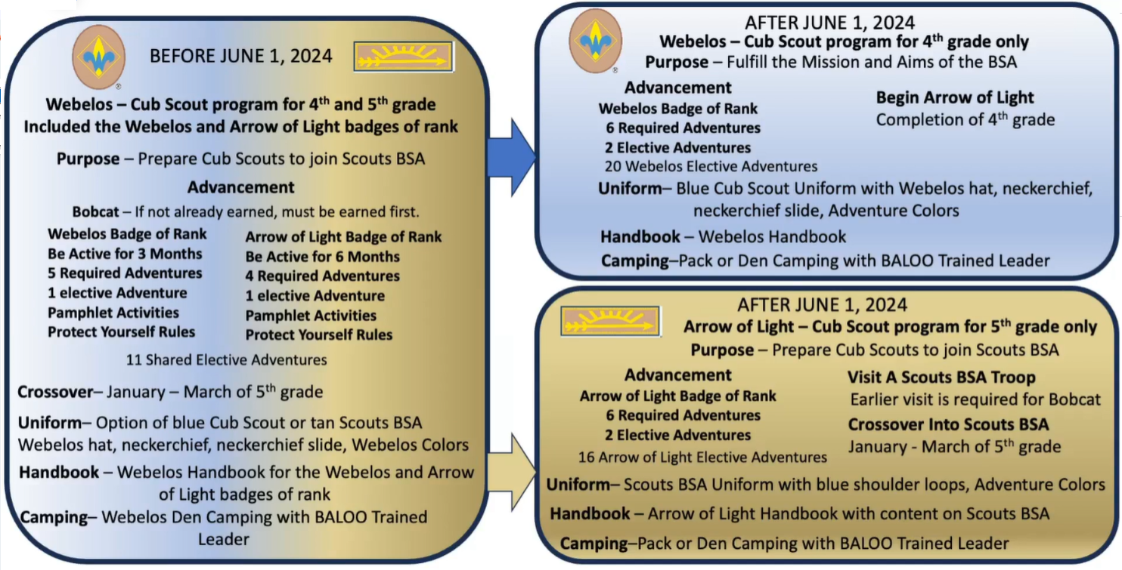
High Level overview of the changes

Slide 42
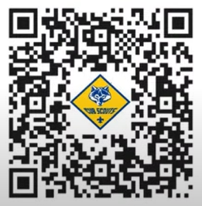
Resources
https://go.scoutingmagazine.org/resources
https://go.scoutingmagazine.org/programsupdates
https://www.scouting.org/topics/program-updates/program-updates-cub-scouts/
https://www.scouting.org/program-updates/cub-scout-program-updates-announced/
https://linktr.ee/cubscoutprogramupdates?fbclid=IwAR10uyTN4Ps6-zxUhxwsqeImia-eSIcbAcyRkTx4mAonjCwwayidIIF_ack

Slide 43
Who Has the First Question?
Alex J. Sobtzak Sr.
Cub Scout Roundtable Commissioner
Withlacoochee District
Greater Tampa Bay Area Council
alex@sobtzak.com
(813)404-4966

